Slide 1
ACS .CHF. PE
3/10/2015
DR.MUHAMMAD AL-JOHANI
ER CONSULTANT

Slide 2
60 year old Female with history of DM2 for 20 years, HTN, HLD who presented to the ED with 4 hour onset of chest pain which was described as in the anterior chest without radiation.
VS: T 36.9, HR: 110, BP: 84/56, RR 22, O2 sat. 93% RA.

Slide 3
What you are going to do ?

Slide 4
CHEST PAIN D.Dx ????

Slide 5
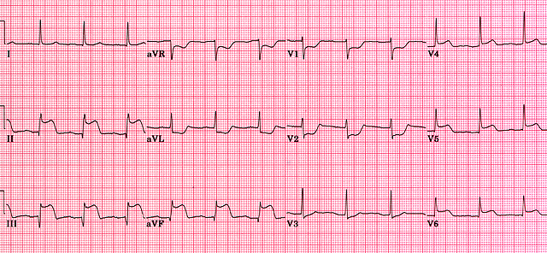

Slide 6
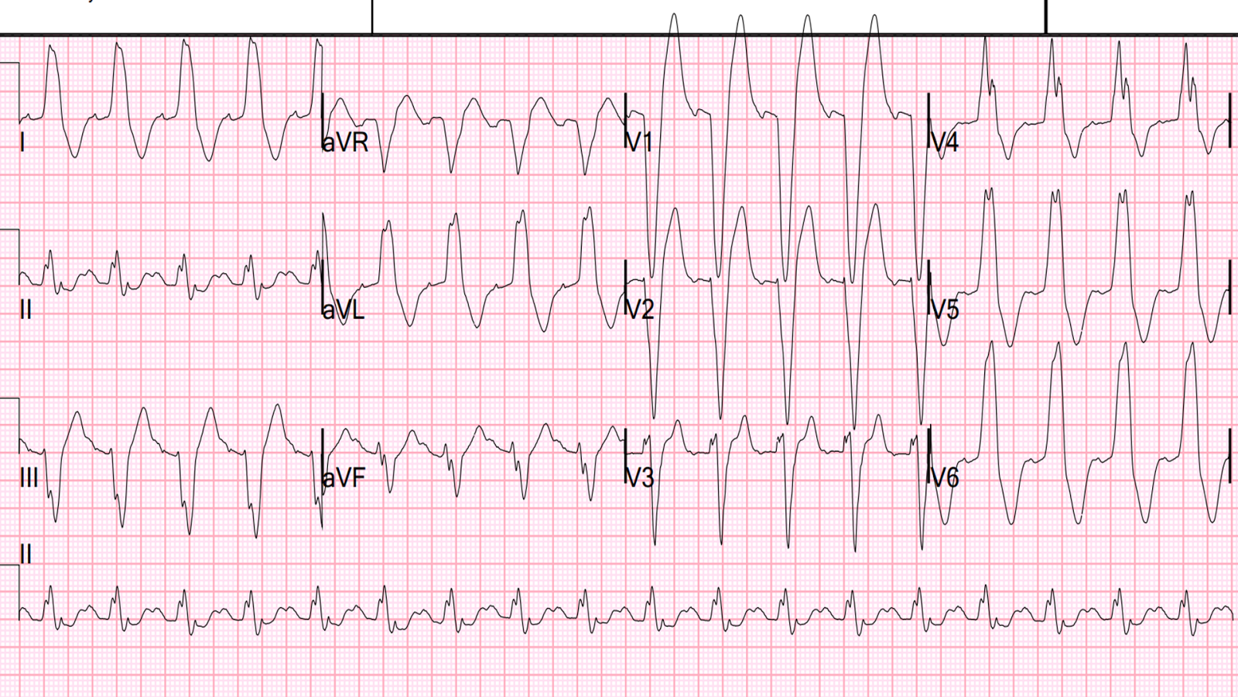

Slide 7
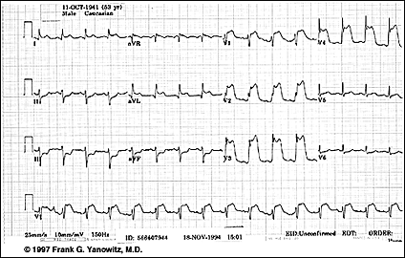

Slide 8
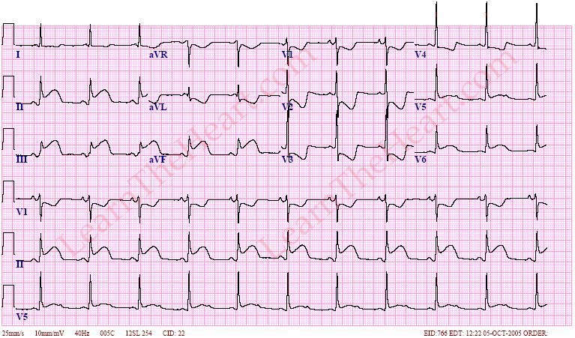

Slide 9
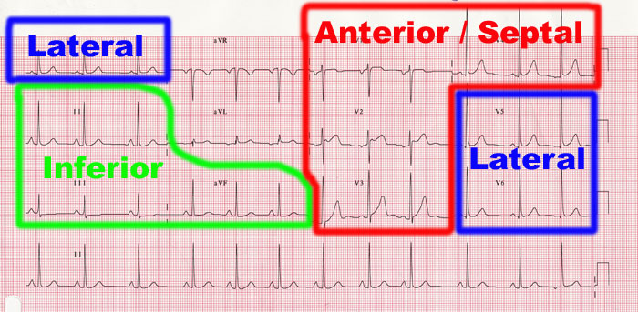

Slide 10
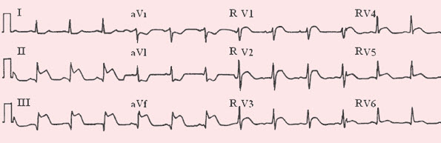

Slide 11
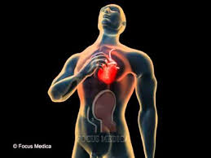
ACS
Definition: a constellation of symptoms related to obstruction of coronary arteries with chest pain being the most common symptom in addition to nausea, vomiting, diaphoresis etc.
Chest pain concerned for ACS is often radiating to the left arm or angle of the jaw, pressure-like in character, and associated with nausea and sweating. Chest pain is often categorized into typical and atypical angina.

Slide 12
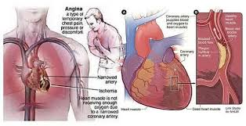
Pathophysiology of ACS
Plaque rupture and subsequent formation of thrombus – this can be either occlusive or non-occlusive (STEMI, NSTEMI, USA)
Vasospasm such as that seen in Prinzmetal’s angina, cocaine use (STEMI, NSTEMI, USA)
Progression of obstructive coronary atherosclerotic disease (USA)
In-stent thrombosis (early post PCI)
In-stent restenosis (late post PCI
Poor surgical technique (post CABG)

Slide 13
ACS CLASSIFICATION
Based on ECG and cardiac enzymes, ACS is classified into:
  STEMI: ST elevation, elevated cardiac enzymes
  NSTEMI: ST depression, T-wave inversion, elevated cardiac enzymes
  Unstable Angina: Non specific EKG changes, normal cardiac enzymes

Slide 14
ANGINA
Stable: There is a stable pattern of onset, duration and
intensity of sx, pain is triggered by a predictable degree of exertion or emotion.
Variant Angina (Prinzmetal's)
  Cyclical, may occur at rest.
Ventricular arrhythmia, brady arrhythmia and conduction disturbances occur.
Syncope associated with arrhythmia may occur
Nocturnal Angina only at night. Possible associated with REM sleep.
Unstable Angina Pre infarction angina
Pain is more intense, lasts longer

Slide 15
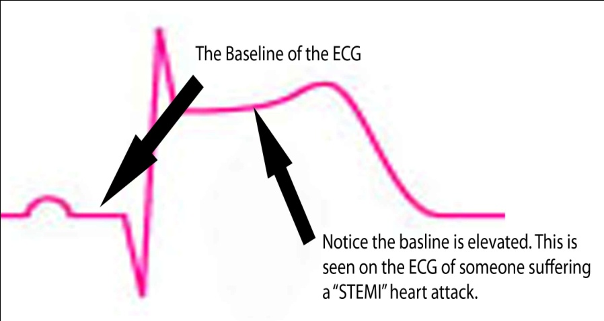
STEMI:
  Q waves , ST elevations, hyper acute T waves; followed by T wave inversions.
  Clinically significant ST segment elevations:
    > than 1 mm (0.1 mV) in at least two anatomical contiguous leads
    or 2 mm (0.2 mV) in two contiguous precordial leads (V2 and V3)

Slide 16
ST ELEVATION D.DX ????

Slide 17
NSTEMI:
  ST depressions (0.5 mm at least) or T wave inversions ( 1.0 mm at least) without Q waves in 2 contiguous leads with prominent R wave or R/S ratio >1.
  Isolated T wave inversions:
    can correlate with increased risk for MI
    may represent Wellen’s syndrome:
      critical LAD stenosis
      >2mm inversions in anterior precordial leads
Unstable Angina:
  May present with nonspecific or transient ST segment depressions or elevations

Slide 18
STEMI Management
STEMI patients usually go straight to the cath lab from the ED. Goal: door to balloon 90 minutes.
Initial management for STEMI:
  Cardiac monitor
  Supplemental O2
  Nitrates*
  Beta blocker
  Morphine
  Clopidogrel
  Aspirin
  Good IV access
  Call cardiology fellow!

Slide 19
Treatment
Acute Angina Treatment
Goal: Enhance 02 supply to myocardium:
M- Morphine for pain
O- Oxygen 4-6L as ordered
N- NTG sublingual, repeat q5 minutes x3
A- Aspirin to prevent platelet aggregation

Slide 20
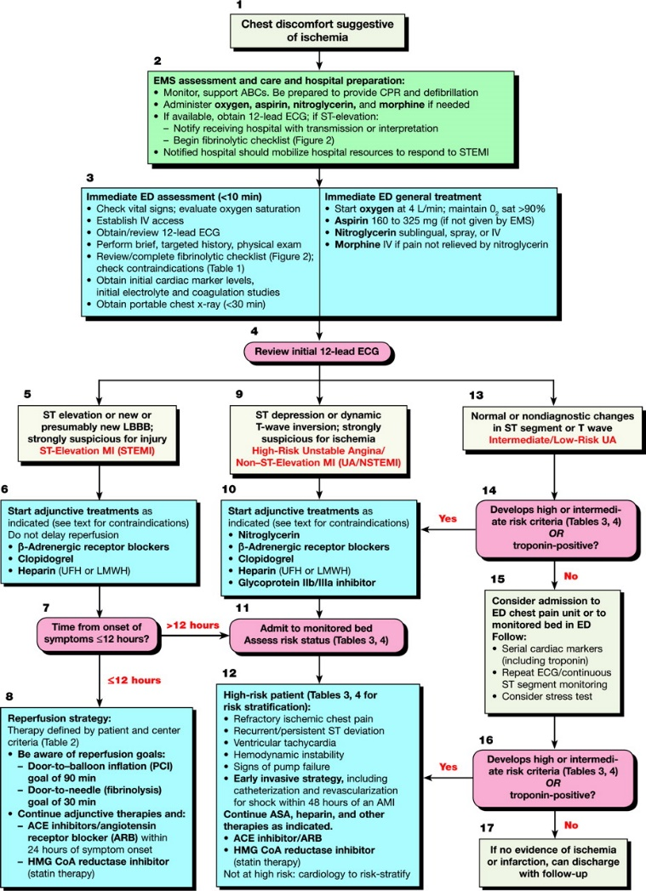

Slide 21
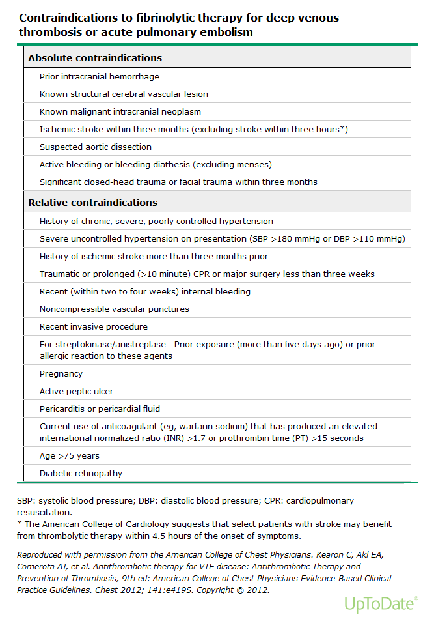

Slide 22
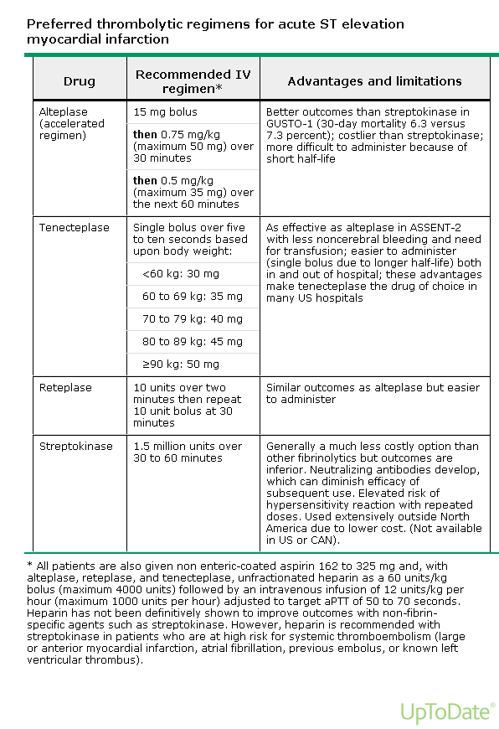
THROMBOLYTICS THERAPY

Slide 23
66-year-old feman with a history of deep venous thrombosis (DVT) presented with acute dyspnea , chest pain and palpiation since 42 hours
Bp 110/80
RR26
HR120
SPO2 84%
TEMP 37 C

Slide 24
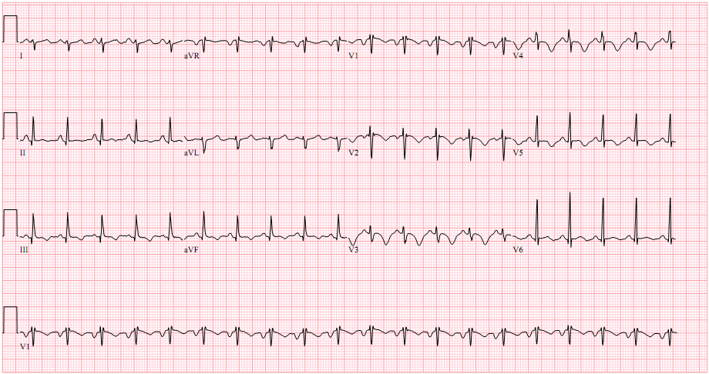
ECG FINDINGS

Slide 25
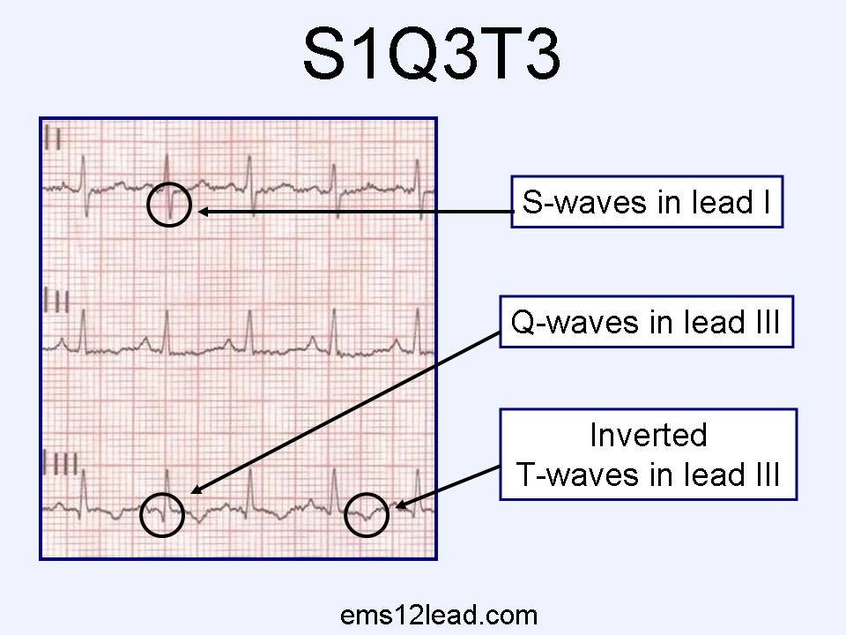
Pulmonary embolism

Slide 26
TYPES
THROMBOEMBOLIC
AIR EMBOLISM
FAT EMBOLISM

Slide 27
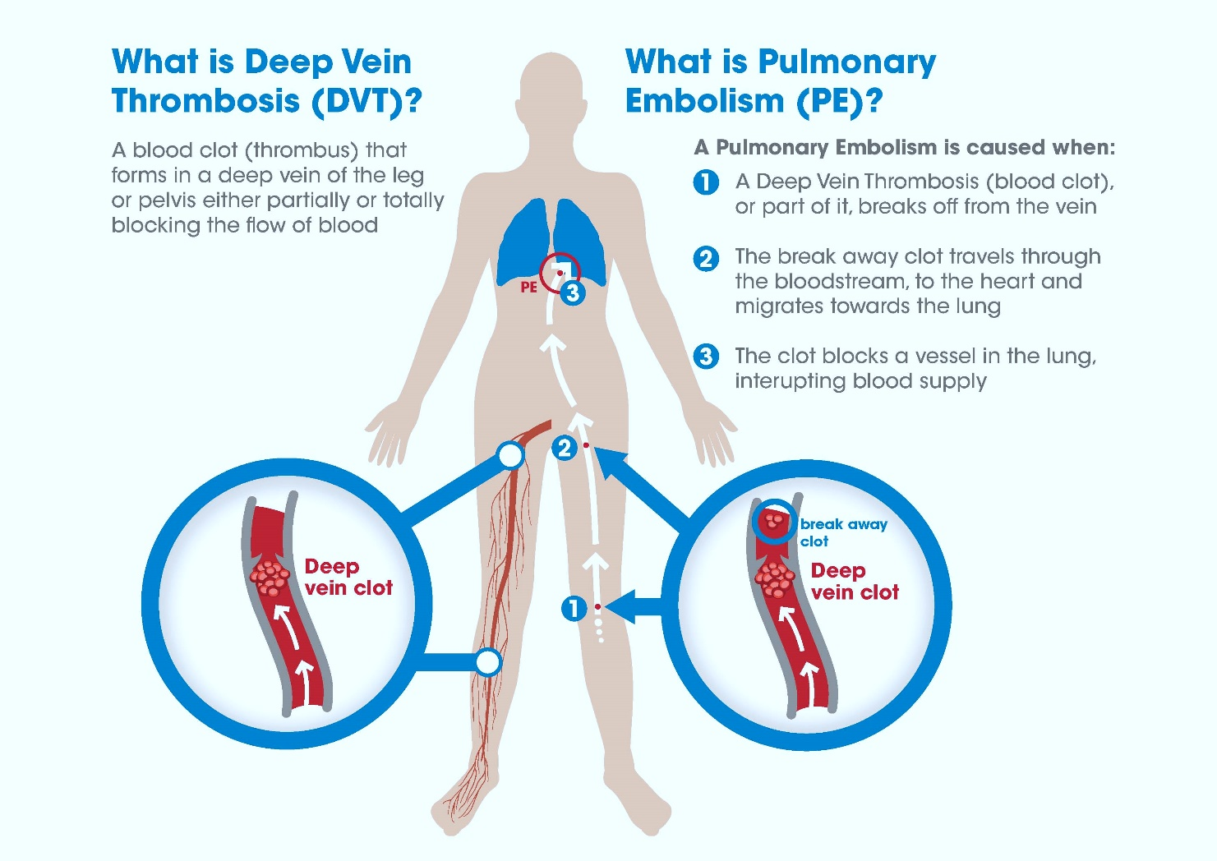

Slide 28
RISK FACTORS :
Hypercoagulable states
Immobilization
Surgery and trauma
Pregnancy
Oral contraceptives and estrogen replacement
Malignancy
Hereditary factors resulting in a hypercoagulable state
Acute medical illness
Drug abuse (intravenous [IV] drugs)
Drug-induced lupus anticoagulant
Hemolytic anemias
Heparin-associated thrombocytopenia
Homocystinemia
Homocystinuria
Hyperlipidemias
Phenothiazines
Thrombocytosis
Varicose veins
Venography
Venous pacemakers
Venous stasis
Warfarin (first few days of therapy)
Inflammatory bowel disease

Slide 29
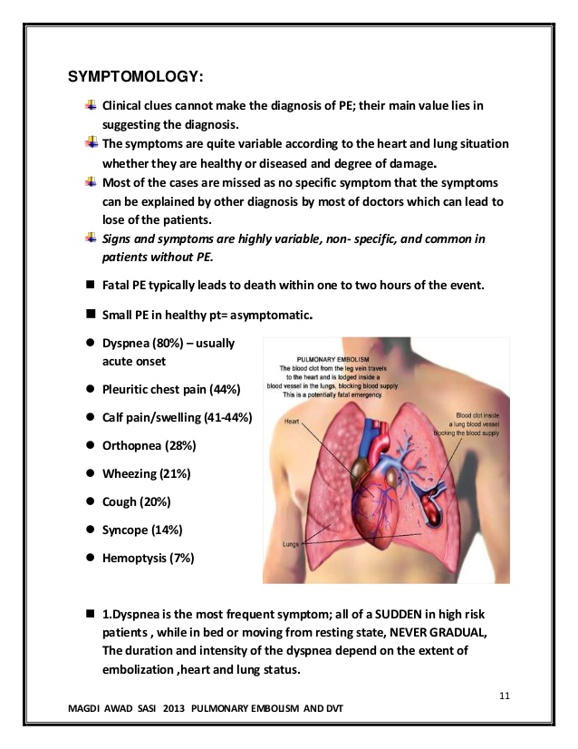

Slide 30
P/E :
Tachypnea (respiratory rate >16/min): 96%
Rales: 58%
Accentuated second heart sound: 53%
Tachycardia (heart rate >100/min): 44%
Fever (temperature >37.8°C): 43%
Diaphoresis: 36%
S ₃ or S ₄ gallop: 34%
Clinical signs and symptoms suggesting thrombophlebitis: 32%
Lower extremity edema: 24%
Cardiac murmur: 23%
Cyanosis: 19%

Slide 31
LABORATORY :
D-dimer testing
Ischemia-modified albumin level
White blood cell count
Arterial blood gases:
Serum troponin levels
Brain natriuretic peptide

Slide 32
Table 1. Modified Wells Prediction Rule for Diagnosing Pulmonary Embolism: Clinical Evaluation Table for Predicting Pretest Probability of Pulmonary Embolism*
Clinical Characteristic | Score
Previous pulmonary embolism or deep vein thrombosis | + 1.5
Heart rate >100 beats per minute | + 1.5
Recent surgery or immobilization (within the last 30 d) | + 1.5
Clinical signs of deep vein thrombosis | + 3
Alternative diagnosis less likely than pulmonary embolism | + 3
Hemoptysis | + 1
Cancer (treated within the last 6 mo) | + 1
Clinical Probability of Pulmonary Embolism | Score
Low | 0-1
Intermediate | 2-6
High | ≥6
*Reprinted from Am J Med, Vol. 113, Chagnon I, Bounameaux H, Aujesky D, et al, Comparison of two clinical prediction rules and implicit assessment among patients with suspected pulmonary embolism, pp 269-75, Copyright 2002.

Slide 33
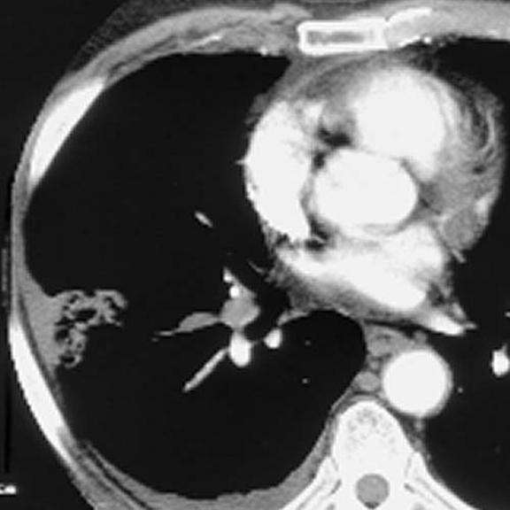
Imaging studies
Computed tomography angiography (CTA): Multidetector-row CTA (MDCTA) is the criterion standard for diagnosing pulmonary embolism
Pulmonary angiography: Criterion standard for diagnosing pulmonary embolism when MDCTA is not available
Chest radiography: Abnormal in most cases of pulmonary embolism, but nonspecific
V/Q scanning: When CT scanning is not available or is contraindicated
ECG: Most common abnormalities are tachycardia and nonspecific ST-T wave abnormalities
MRI: Using standard or gated spin-echo techniques, pulmonary emboli demonstrate increased signal intensity within the pulmonary artery
Echocardiography: Transesophageal echocardiography may identify central pulmonary embolism
Venography: Criterion standard for diagnosing DVT
Duplex ultrasonography: Noninvasive diagnosis of pulmonary embolism by demonstrating the presence of a DVT at any site

Slide 34
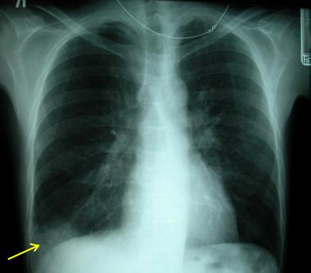
X RAY FINDINGS :
Common radiographic abnormalities include atelectasis, pleural effusion, parenchymal opacities, and elevation of a hemidiaphragm. The classic radiographic findings of pulmonary infarction include a wedge-shaped, pleura-based triangular opacity with an apex pointing toward the hilus (Hampton hump) or decreased vascularity (Westermark sign). These findings are suggestive of pulmonary embolism but are infrequently observed.
A prominent central pulmonary artery (knuckle sign), cardiomegaly (especially on the right side of the heart), and pulmonary edema are other findings

Slide 35
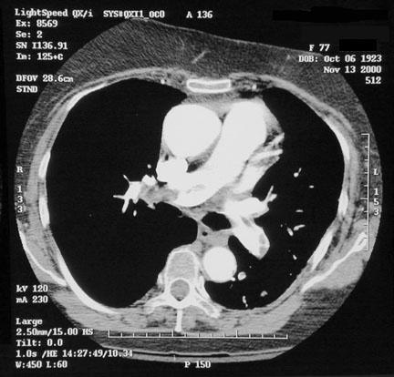

Slide 36
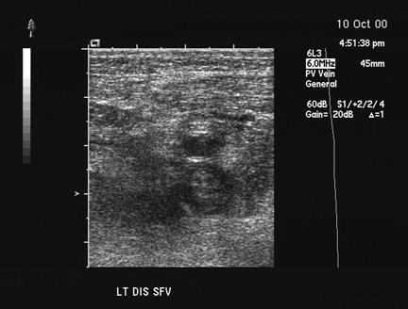
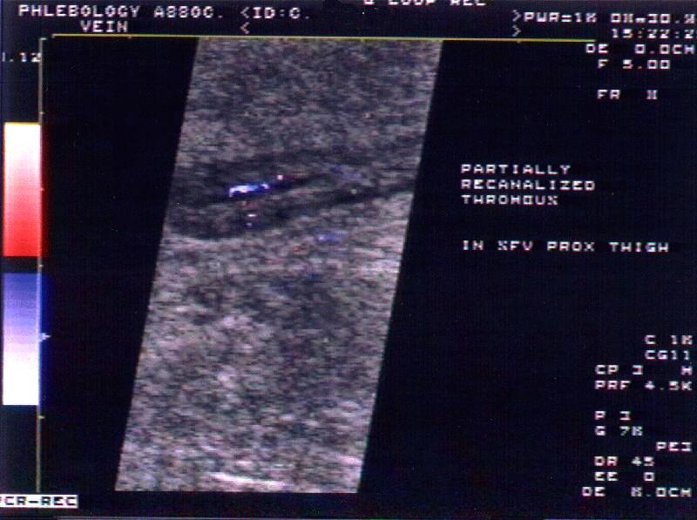

Slide 37
Management
Anticoagulation medications include the following:
Unfractionated heparin
Low-molecular-weight heparin
Fondaparinux
Warfarin
Thrombolytic agents used in managing pulmonary embolism include the following:
Alteplase
Reteplase
Urokinase
Streptokinase
Surgical options
Surgical management options include the following:
Catheter embolectomy and fragmentation or surgical embolectomy
Placement of vena cava filters

Slide 38
Potential indications for thrombolytic therapy in venous thromboembolism
Presence of hypotension related to PE*
Presence of severe hypoxemia
Substantial perfusion defect
Right ventricular dysfunction associated with PE
Extensive deep vein thrombosis

Slide 39
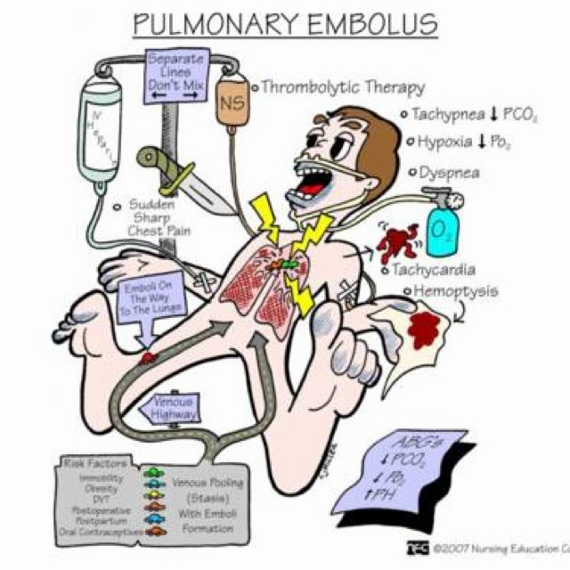

Slide 40
67 YS OLD FEMALE , DM ,HTN ,CHRONIC RENAL IMPAIRMENT
PRESENTED WITH SEVER SOB , SHALLOW BREATHING FOR 1 HOUR AT HOME
BP 220/130
HR130
RR30
SPO2 70% RA
TEMP 38C

Slide 41
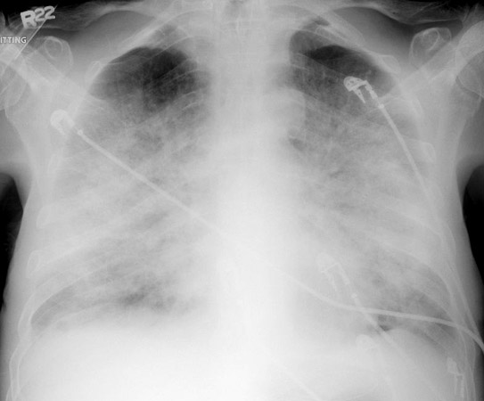

Slide 42
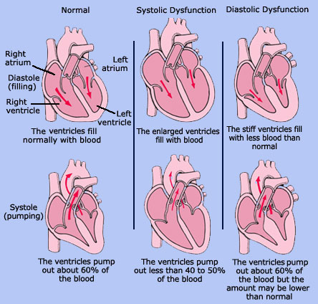
CONGESTIVE HEART FAILURE

Slide 43
Classifications- (how to describe)
Systolic versus diastolic
  Systolic- loss of contractility get dec. CO
  Diastolic- decreased filling or preload
Left-sided versus right –sided
  Left- lungs
  Right-peripheral
High output- hypermetabolic state
Acute versus chronic
  Acute- MI
  Chronic-cardiomyopathy

Slide 44
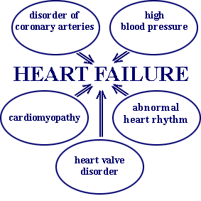
Heart Failure
Etiology and Pathophysiology
Primary risk factors
  Coronary artery disease (CAD)
  Advancing age
Contributing risk factors
  Hypertension
  Diabetes
  Tobacco use
  Obesity
  High serum cholesterol
  African American descent
  Valvular heart disease
  Hypervolemia

Slide 45
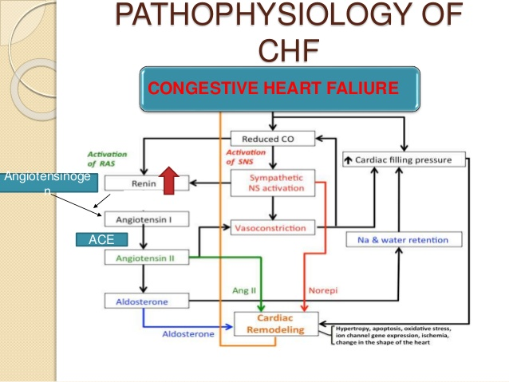

Slide 46
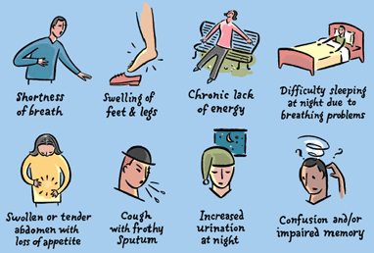
Symptoms

Slide 47
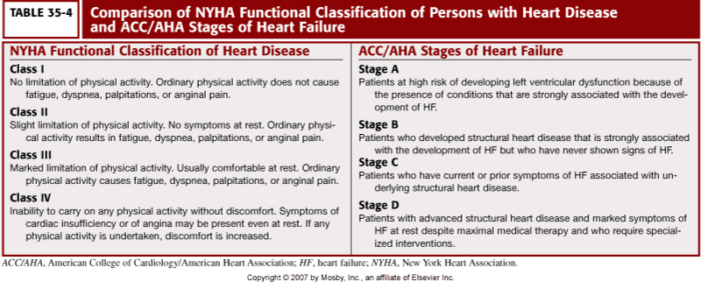

Slide 48
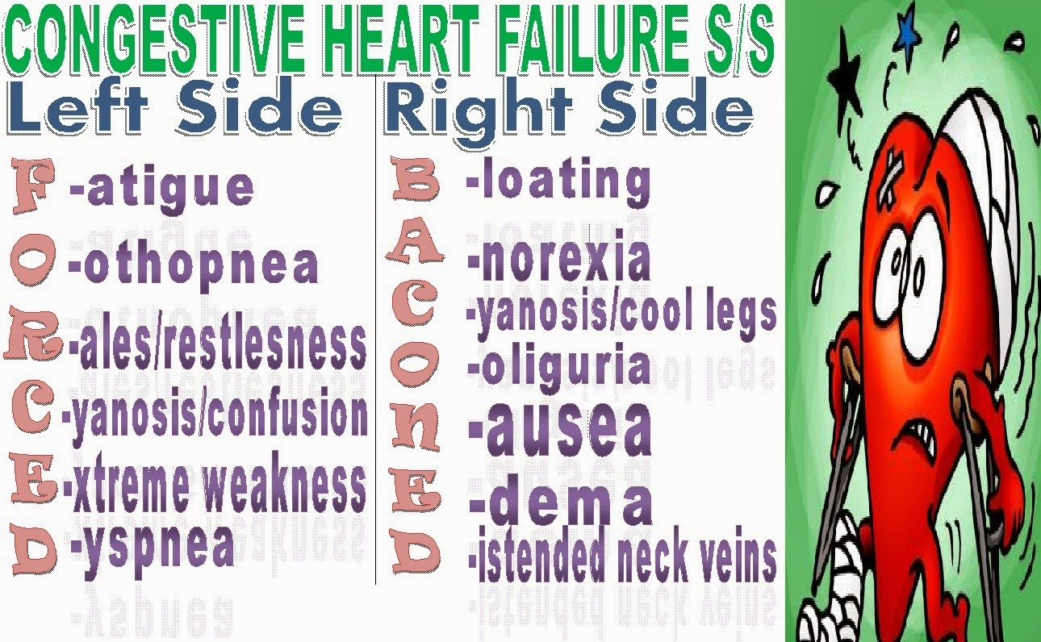

Slide 49
DIAGNOSIS :
The American College of Cardiology/American Heart Association (ACC/AHA),^{[3]} Heart Failure Society of America (HFSAand European Society of Cardiology (ESC) recommend the following basic laboratory tests and studies in the initial evaluation of patients with suspected heart failure:
Complete blood count (CBC), which may indicate anemia or infection as potential causes of heart failure
Urinalysis (UA), which may reveal proteinuria, which is associated with cardiovascular disease
Serum electrolyte levels, which may be abnormal owing to causes such as fluid retention or renal dysfunction
Blood urea nitrogen (BUN) and creatinine levels, which may indicate decreased renal blood flow
Fasting blood glucose levels, because elevated levels indicate a significantly increased risk for heart failure (diabetic and nondiabetic patients)
Liver function tests (LFTs), which may show elevated liver enzyme levels and indicate liver dysfunction due to heart failure
B-type natriuretic peptide (BNP) and N-terminal pro-B-type (NT-proBNP) natriuretic peptide levels, which are increased in heart failure; these measurements are closely correlated with the NYHA heart failure classification
Electrocardiogram (ECG) (12-lead), which may reveal arrhythmias, ischemia/infarction, and coronary artery disease as possible causes of heart failure

Slide 50
IMAGING STUDY :
CXR
ECHO

Slide 51
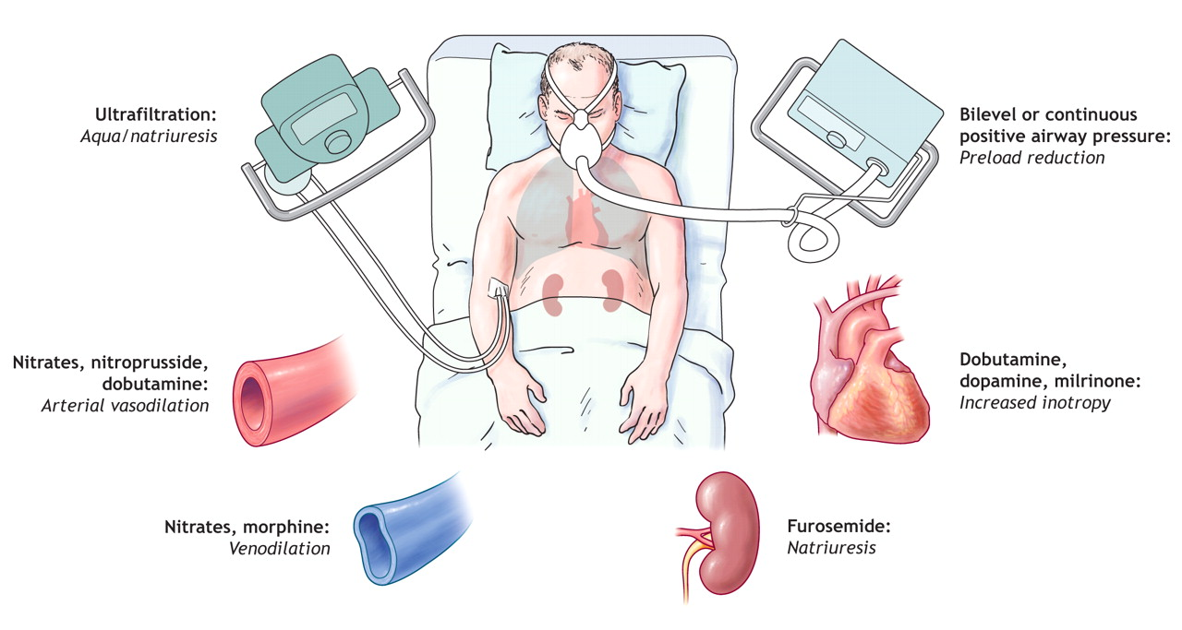
TREATMENT :

Slide 52
A 35-year-old man presents to the emergency department with pleuritic chest pain that began about 7 hours ago. He states that the pain is sharp, radiates to his left shoulder, and is alleviated by leaning forward. He reports having flu-like symptoms for the past week. He is worried that he is having a heart attack because he has a
“lousy” family history. Which of the following would make a acute myocardial infarction (MI) as a diagnosis in this patient most unlikely?
(A) Absence of Q waves on the electrocardiogram (ECG)
(B) Lack of response to a trail of nitroglycerin (NTG)
(C) The patient’s young age
(D) Radiation of the pain to the left shoulder
(E) Positive family history

Slide 53
Nitroglycerin (NTG) therapy is contraindicated for which of the following?
(A) Unstable angina
(B) Anterior wall myocardial infarction (MI)
(C) Inferior wall MI
(D) Right ventricular MI
(E) Lateral wall MI

Slide 54
Which of the following electrocardiogram patterns is most consistent with occlusion of the right coronary artery?
(a) ST-segment elevation in V1, V2 and V3.
(b) R waves in V1 and V2 > 0.04 s and R/S ratio ≥ 1.
(c) ST-segment elevation is I and aVL.
(d) ST-segment elevation in II, III, and aVF

Slide 55
An 85-year-old female presents with acute onset of dyspnea, inspiratory rales, and holosystolic murmur. Her electrocardiogram reveals Q waves in II, III and aVF. Approximately five days earlier, she relates, she had a "severe bout of heartburn." Cardiac enzymes are significant for a normal CK-MB but elevated troponin. What is the most likely cause of this patient's symptoms?
(a) Left ventricular free wall rupture.
(b) Pulmonary embolism
. (c) Dressler syndrome.
(d) Papillary muscle rupture

Slide 56
Which of the following therapeutic agents has been shown to unequivocally decrease mortality in the setting of acute myocardial infraction?
(a) Aspirin
(b) Calcium channel antagonisits.
(c) Magnesium.
(d) Glycoprotein IIb/IIIa inhibito

Slide 57
A 50-year-old male presents with an acute inferior wall myocardial infraction, following the administration of aspirin and nitroglycerin, he suddenly becomes confused and diaphoretic with a blood pressure of 70/30 mmHg. Physical examination reveals jugular venous distention, clear lung fields, and no evidence of murmur. What combination of therapeutic agents is most likely to immediately stabilize this patient?
(a) Heparin and glycoprotein IIb/IIIa inhibitors.
(b) Angiotensin converting enzyme inhibitor and clopidogrel.
(c) Streptokinase and magnesium.
(d) Normal saline bolus and dobutamine

Slide 58
Which of the following is NOT part of Virchow's triad of risk factors for venous thromboembolism?
(a) Venous stasis.
(b) Malignancy.
(c) Vessel wall injury.
(d) Hypercoagulable stat

