Slide 1
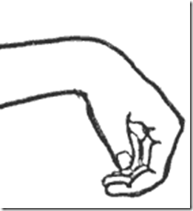
Saturday Night Palsy

Slide 2
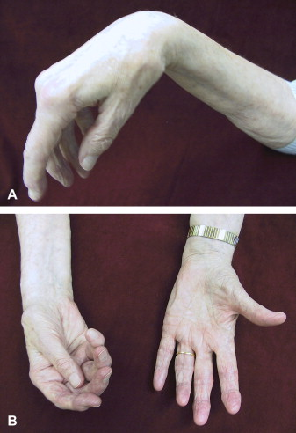
What’s Saturday night palsy?
Also known as wrist drop, or radial nerve palsy.
It’s a condition where a person can not extend their wrist.
It’s called “Saturday night palsy” because most people drink on Saturday as a weekend, and sleep in an unknown position in which there arm pit is compressed against the edge of the chair or couch leaving their hand hanging overnight. When they wake up, they can’t extend their wrist (wrist drop)

Slide 3
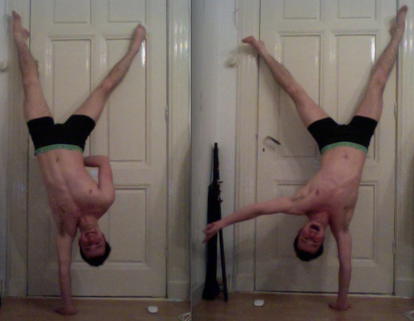
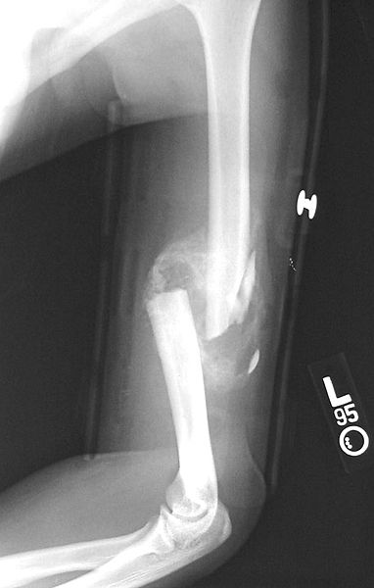
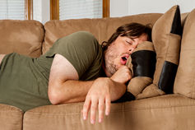
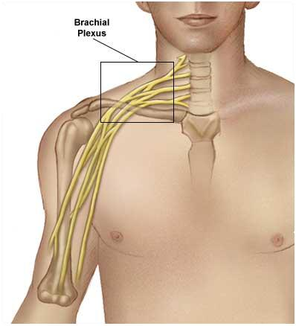
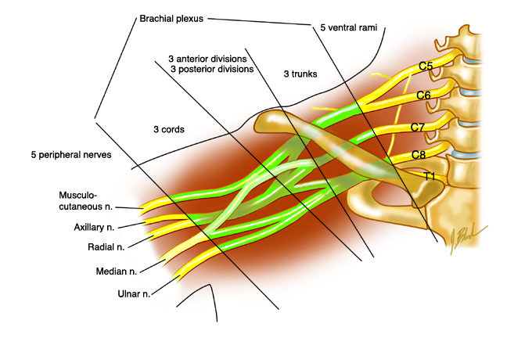
causes
Main causes of Saturday night palsy :
Wrong sleeping (compression on radial nerve)
Stab wounds to the chest, at or below the clavicle (may affect brachial plexus)
Fractures (humerus)
Long-term pressure on the nerve, usually caused by swelling or injury of nearby body structures

Slide 4
Morphology
Presentation
The patient has injured his upper arm, usually by sleeping with his arm over the back of a chair, and now presents holding the affected hand and wrist with his good hand, complaining of decreased or absent sensation on the radial and dorsal side of his hand and wrist, and of inability to extend his wrist, thumb and finger joints. With the hand supinated (palm up) and the extensors aided by gravity, hand function may appear normal, but when the hand is pronated (palm down) the wrist and hand will drop.
What to do:
Look for associated injuries. This sort of nerve injury may be associated with cervical spine fracture, injury to the brachial plexus in the axilla, or fracture of the humerus.

Slide 5
Symptoms of an Injury to the Radial Nerve
Symptoms may include:
sharp or burning pain
numbness or tingling
trouble straightening the arm
trouble moving the wrist and fingers
“drooping” of the wrist and fingers (not being able to extend or
straighten the wrist or fingers), also called “wrist drop”
weakness in a hand grip

Slide 6
Prognosis
This neuropathy is produced by compression of the radial nerve as it spirals around the humerus . Most commonly it occurs when a person falls asleep, intoxicated, held up by his arm thrown over the back of a chair..
If the injury to the radial nerve is at the elbow or just below, there may be sparing of the wrist radial extensors as well as the radial nerve autonomous sensation. The deficient groups will be the wrist ulnar extensors as well as the metacarpophalyngeal extensors. A high radial palsy in the axilla will involve all of the radial nerve innervations, including the triceps.

Slide 7
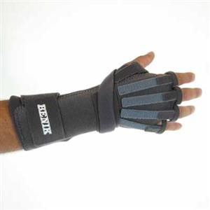
Treatment
First-Line Treatment
Treatment options include:
pain medication
steroid injections
anesthetic creams
braces or splints
physical therapy to help build and maintain muscle
strength
massage

Slide 8
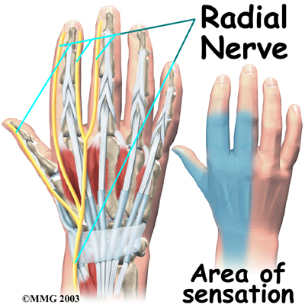
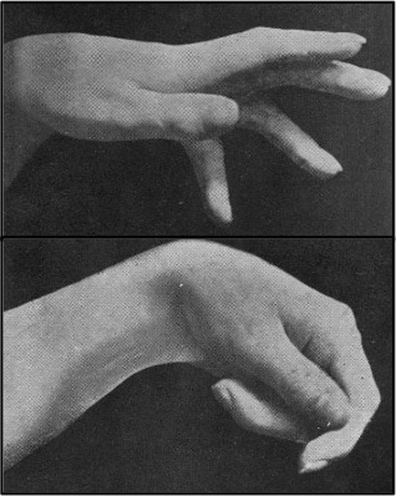
Complication of Saturday Night Palsy
Complication include permanent :
nerve damage that results in partial or complete loss of wrist and hand movement or sensation,
muscular atrophy,
chronic pain, wrist / finger flexion contracture and loss of function

Slide 9
How Can I Prevent Radial Nerve Injury?
Avoiding prolonged pressure on the upper arm can
prevent most cases of radial nerve injury.
Avoid other behaviors that can lead to nerve damage,
such as repetitive motions or cramped positions when
sitting or sleeping.
If nerve damage is the result of an underlying medical
condition, such as diabetes or alcoholism, talk to your
doctor about how to manage your symptoms.

Slide 10
Nada Abdulmalik – Definition
Hibah Al-Owais – Causes
Arwa Al-Mahmoud – Morphology
Rydaa Otay - Prevention
Walaa Abdulkarim – Prognosis
Njood - Complications

Slide 11
Thank you
(^_^)

