Slide 1
Gastric Secretion
بسم الله الرحمن الرحيم
Dr.Mohammed Sharique Ahmed Quadri
Assistant Professor Physiology
Almaarefa College

Slide 2
Objectives
Describe the three types of gastric exocrine secretory cells and there secretions.
Summarize the mechanism of HCl secretion in stomach.
Explain the role of HCl and pepsinogen in digestion.
Emphasize the protective role of mucus and its applied importance.
Describe the multiple regulatory pathways that control stomach secretion.
Appraise the role of stomach in digestion and absorption.

Slide 3
GASTRIC SECRETION
Gastric Secretion is about 2 liters – per day.
There are Gastric Glands present in the stomach.
They open at the surface of the stomach by opening called ‘Gastric Pits’.
Gastric Glands have exocrine and endocrine cells.

Slide 4
Gastric Secretions
Two distinct areas of gastric mucosa that secrete gastric juice
Oxyntic mucosa
Lines body and fundus
Pyloric gland area (PGA)
Lines the antrum

Slide 5
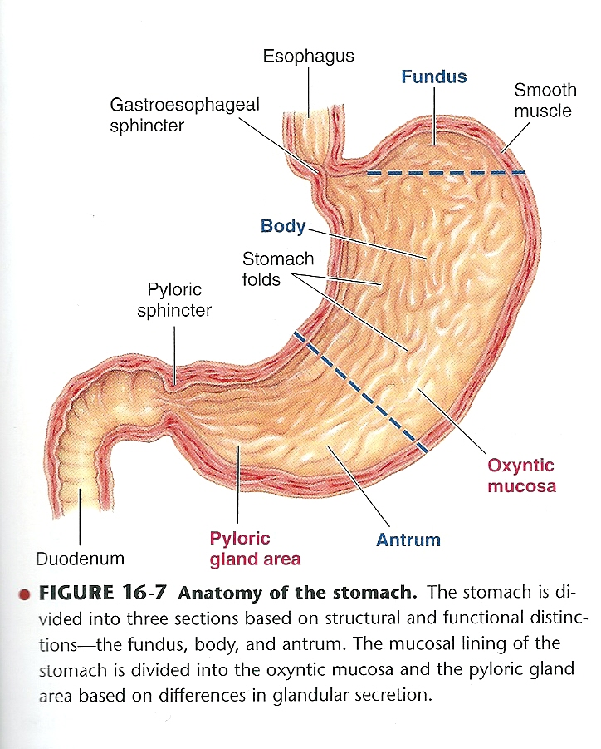

Slide 6
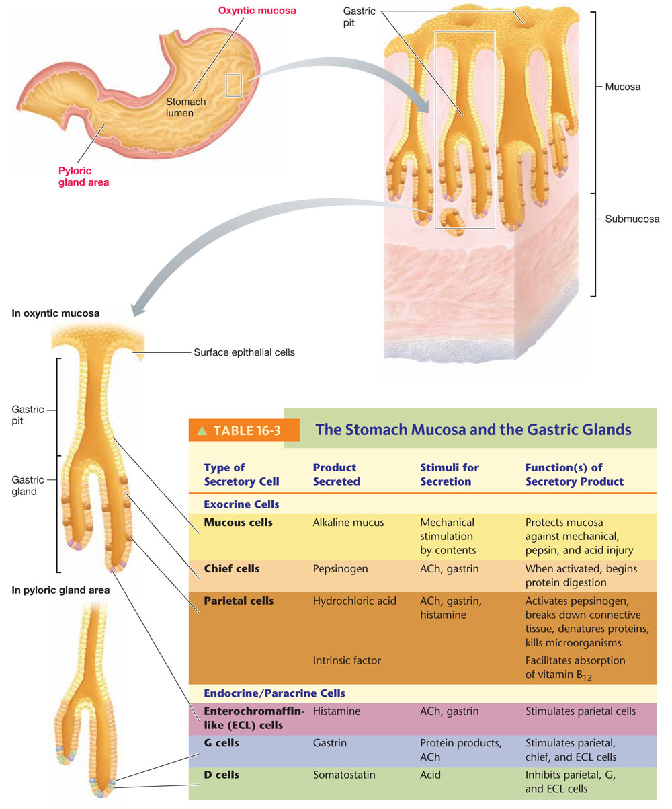

Slide 7
GASTRIC SECRETION
Exocrine cells in Gastric Gland are of three types:
1. Mucus Cells – they secrete thin watery mucus.
2. Chief Cells – they secrete enzyme precursor pepsinogen. Chief cells are present in oxyntic mucosa ( fundus and body )
3. Parietal [Oxyntic cells] – they secrete HCL and intrinsic factor. They are present in fundus and body.

Slide 8
GASTRIC SECRETION
All exocrine secretion are released in Gastric lumen and make up the gastric digestive juice.
Between the Gastric pits, gastric mucosa is covered by surface epithelial cells, which secrete a thick, viscous, alkaline mucus several millimeter thick over the surface of mucosa.

Slide 9
GASTRIC SECRETION
Endocrine – Paracrine cells in stomach.
ECL Cells( Entero Chromaffin Cells ) – they secrete Histamine and stimulate parietal cells to produce HCL. They are present in fundus and body [Oxyntic mucosa].
G–Cells – present in the antrum [Pyloric Gland Area PGA]. They secrete Gastrin hormone which stimulate parietal, chief and ECL [Entero Chromaffin Like cells].
D–Cells – present in PGA. They secrete somatostatin and they inhibit parietal, G-cells and ECL cells.

Slide 10
GASTRIC SECRETION
Let us consider Exocrine products and their role in Digestion:
1. HCL – is secreted by parietal [Oxyntic] cells in the lumen of stomach, therefore, pH in stomach lumen is below 2.

Slide 11
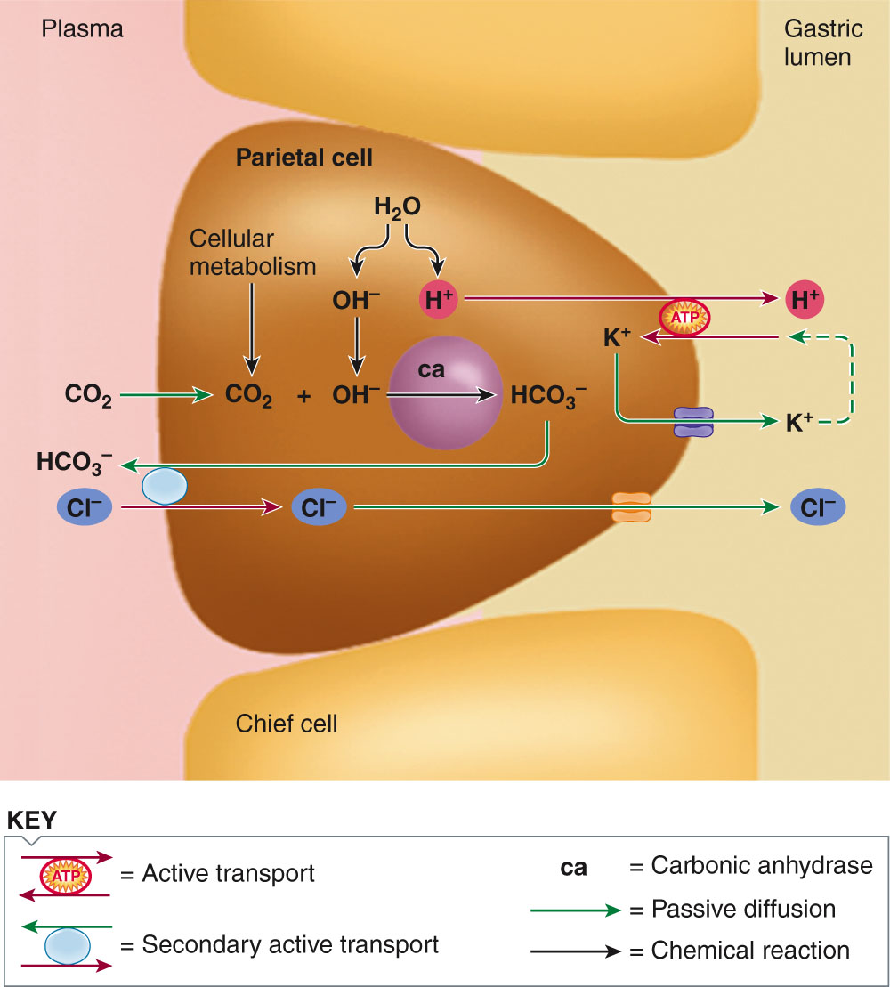
Mechanism of HCL Secretion

Slide 12
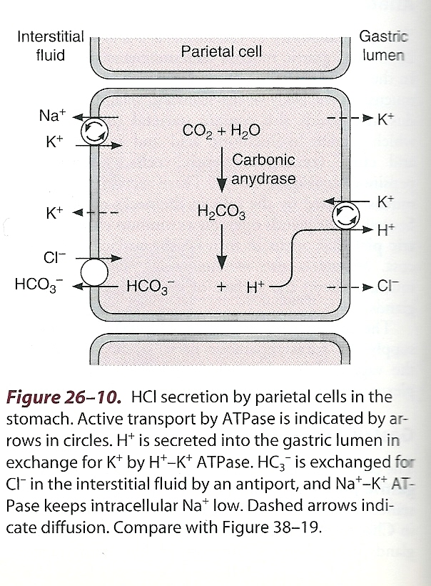
Hydrogen [H+] is actively transported in parietal cell membrane, from cell to the lumen.
Chloride [Cl-] is secreted by secondary active transport mechanism.

Slide 13
Functions of Gastric Juice
Functions of HCL
HCL activates pepsinogen to active enzyme pepsin.
It provides acid medium in which pepsin acts optimally .
HCL breaks down connective tissue and muscle fibers reducing large food particle into smaller particle.
Denatures protein
It kills micro organism ingested with food.

Slide 14
Functions of Gastric Juice
Functions of Pepsinogen
Pepsinogen, an inactive enzyme produced by chief cells.
It is stored in zymogen granules in the secretary vesicles in the cytoplasm of chief cells.
It is released by exocytosis.
Pepsinogen is converted to active pepsin by HCL.

Slide 15
Functions of Gastric Juice
Functions of Pepsinogen
Once pepsin in formed in lumen, it acts on pepsinogen molecule to produce more pepsin [autocatalytic or self-activating process].
Pepsin initiates protein digestion.
It works optimally in acidic medium.

Slide 16
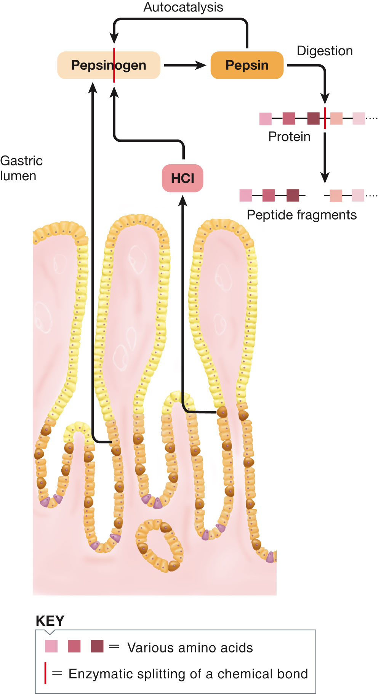
Pepsinogen activation in stomach lumen

Slide 17
Functions of Gastric Juice
Functions of Mucus
Surface of gastric mucosa is covered by mucus.
It is derived from surface epithelial cells and mucous cells.
Mucus works as protective barrier.
It protects stomach wall from self-digestion by pepsin.
As mucus is alkaline, pH 7 – it protects stomach from HCL [pH 2].
Lubrication : protection from mechanical injury

Slide 18
Functions of Gastric Juice
Intrinsic Factor
It is secreted by parietal cells.
It is essential for absorption of vitamin B12 [vitamin B12 is only absorbed when in combination with intrinsic factor].
Intrinsic factor – vitamin B12-complex have special receptors in TERMINAL ILEUM, where vitamin B12 is absorbed.
Vitamin B12 is essential for normal formation of RBC.
If no intrinsic factor, vitamin B12 is not absorbed, it causes pernicious anemia (either in deficiency of intrinsic factor or gastrectomy).

Slide 19
GASTRIC JUICE
Endocrine & Paracrine cell in Gastric glands
G-cell [Gastrin Cell] - Gastrin ( antrum )
ECL [Entero Chromaffin Cell] – Histamine ( Fundus and body )
D-cell – Somatostatin ( pylorus antrum )
Gastrin ,Histamine, Acetylcholine [ACh] are Stimulatory and increase HCL secretion.
Somatostatin inhabits HCL secretion.
ACh and Gastrin increase pepsinogen by acting on chief cells.

Slide 20
GASTRIC JUICE
Endocrine & Paracrine Functions
We will consider these chemical messengers in further detail.
1. Acetylcholine – neurotransmitter released due to vagal stimulation and in response to short local reflexes [enteric nervous system].
ACh stimulates both parietal and chief cells, as well as, G-cells and ECL cells.

Slide 21
GASTRIC JUICE
2. Gastrin
Secreted by G-cells present in antrum.
Gastrin is major GIT hormone.
Gastrin is secreted in response to protein products in lumen of stomach and in response to ACh.
Gastrin is carried by blood to the fundus and body of the stomach and stimulates parietal and chief cells, therefore, causes secretion of HCL and pepsinogen.
Gastrin also stimulates ECL to release histamine and increase HCL secretion.
Gastrin is the main factor that increases HCL during meal digestion.
Gastrin causes growth of mucosa of stomach and small intestine.

Slide 22
GASTRIC JUICE
3. Histamine
Is Paracrine - released from the ECL cells in response to ACh and gastrin.
Histamine acts locally on nearby parietal cells to increase HCL secretion.
Histamine acts via cAMP.
4. Somatostatin
Released by D-cells present in the pylorus [also in duodenum] in response to acid.
It acts locally as paracrine and inhibits secretion of parietal cell, G-cell, and ECL cell.

Slide 23
Factors affecting H⁺ ion secretion
Alcohol & caffein also stimulate HCl secretion

Slide 24
CONTROL OF GASTRIC SECRETION
It involves Three phases:
1. Cephalic Phase
2. Gastric Phase
3. Intestinal Phase
Cephalic Phase
It means there is increase secretion of HCL and pepsinogen [Gastric juice before food reaches the stomach].
Stimuli are thinking, smelling, tasting, chewing and swallowing.
Increased gastric secretion occurs due to vagal nerve activity. Vagus stimulates intrinsic plexus and increases ACh secretion, therefore, increase HCL and pepsinogen.
Vagus also stimulates G-cells in PGA, therefore, release of gastrin which increases HCL and pepsinogen.

Slide 25
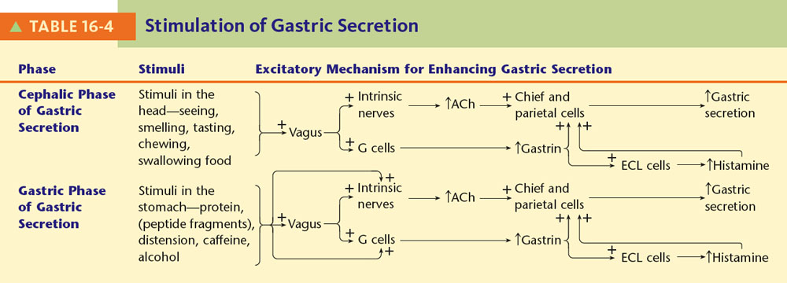

Slide 26
CONTROL OF GASTRIC SECRETION
2. Gastric Phase
Gastric phase begins when food reaches the stomach.
Stimuli acting in the stomach are protein, caffeine, distension, alcohol.
Protein is most potent stimulus – acts via local plexus and vagus nerve.
Protein also stimulates G-cells to release gastrin.
Important – People with hyper-acidity or peptic ulcer should avoid caffeine and alcohol.

Slide 27
CONTROL OF GASTRIC SECRETION
3. Intestinal Phase
When food enters the small intestine, it influences gastric secretion.
Intestinal phase is inhibitory.
As Chyme enters small intestine, it reflexly decreases the gastric secretion.

Slide 28
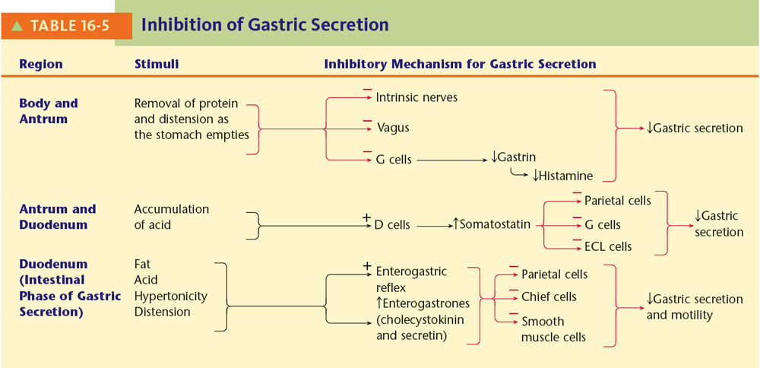

Slide 29
How Gastric Secretion Decreases After It Is Produced?
It decreases by three ways:
i). As meal gradually leaves the stomach, major stimulus that is protein in stomach is withdrawn.
ii). Somatostatin is released when food goes to duodenum. It has inhibitory effect.
iii). Stimuli which inhibit gastric motility are fat, acid, hypertonicity or distension in the duodenum.

Slide 30
How Stomach Is Protected From Acidity & Enzyme Pepsin?
It is protected by :
Mucus Layer
Mucus Secreting cells [mucus pH is 7] – secrete HCO3 which neutralizes acid [luminal pH is 2].
Cells are impermeable to H+ ion, therefore, HCL can not penetrate into the cells.
Entire stomach lining is replaced every 3 days.

Slide 31
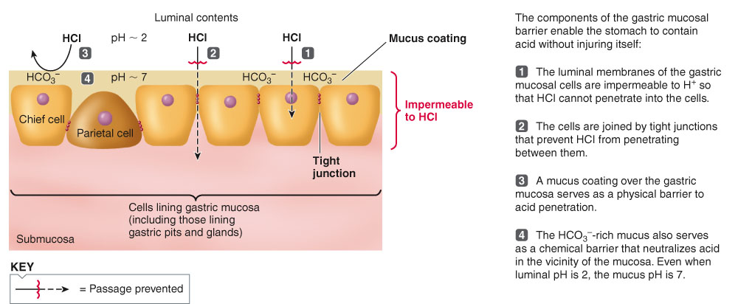

Slide 32
STOMACH
We have discussed
1. Motility
2. Secretion in Stomach
Now we will consider
3. Digestion in Stomach
4. Absorption in Stomach

Slide 33
Digestion in Stomach
Protein digestion begins in the antrum of stomach, where food is mixed with HCL and pepsin.
Carbohydrate digestion which started in mouth due to action of salivary amylase, continues in the stomach, till α-amylase is destroyed by the HCL.

Slide 34
Absorption in Stomach
No food or water is absorbed in the stomach.
Stomach absorbs alcohol and aspirin.
Alcohol is lipid soluble, therefore, can diffuse through lipid membrane of epithelial cell lining of stomach.
Alcohol is absorbed more rapidly in small intestine.

Slide 35
Clinical Application
Peptic Ulcer
Ulcer or erosion in the stomach, duodenum or esophagus can occur due to increased acidity and pepsin.
In 1990, a bacterium ‘HELICOBACTER PYLORI’ was identified as cause of peptic ulcer.
H.Pylori bacteria resides below the protective mucus layer.
H.Pylori usually settles in the antrum which has no acid producing parietal cells, although acid reaches the antrum.

Slide 36
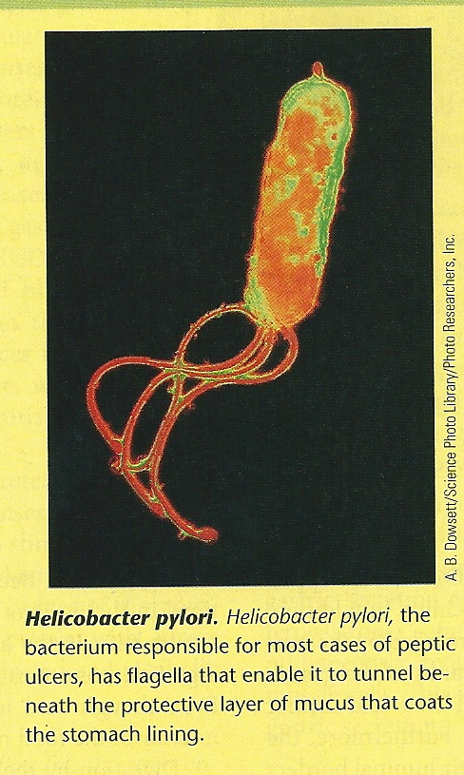

Slide 37
How H.Pylori Causes Peptic Ulcer?
It causes peptic ulcer:
By toxins which cause gastritis.
By weakening gastric mucosal barrier.
OTHER FACTOR THAT CAUSE PEPTIC ULCER
Ethyl alcohol
NSAIDS [Non Steroidal Anti-Inflammatory Drugs] e.g. aspirin, IBUPROFIN [used for arthritis, pain].
Stress – probably by increased gastric secretion.

Slide 38
TREATEMENT FOR PEPTIC ULCER
Anta-acid
H2 Histamine receptor blocker e.g. Cemitidine, Ranitidine
Proton pump blocker [it blocks H+ - K+ ATP pump] e.g. OMEPRAZOLE
Anti - biotic for H.Pylori

Slide 39
References
Human physiology by Lauralee Sherwood, seventh edition
Text book physiology by Guyton &Hall,11th edition
Text book of physiology by Linda .s contanzo,third edition

