Slide 1
Treatment of Arthritis
Dr. Kaukab Azim

Slide 2
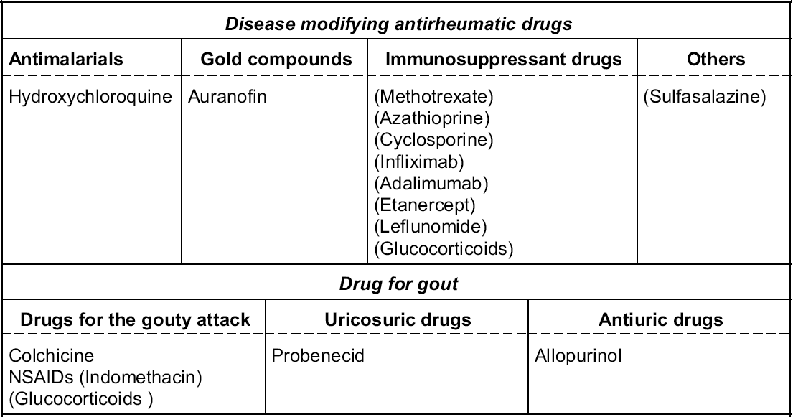

Slide 3
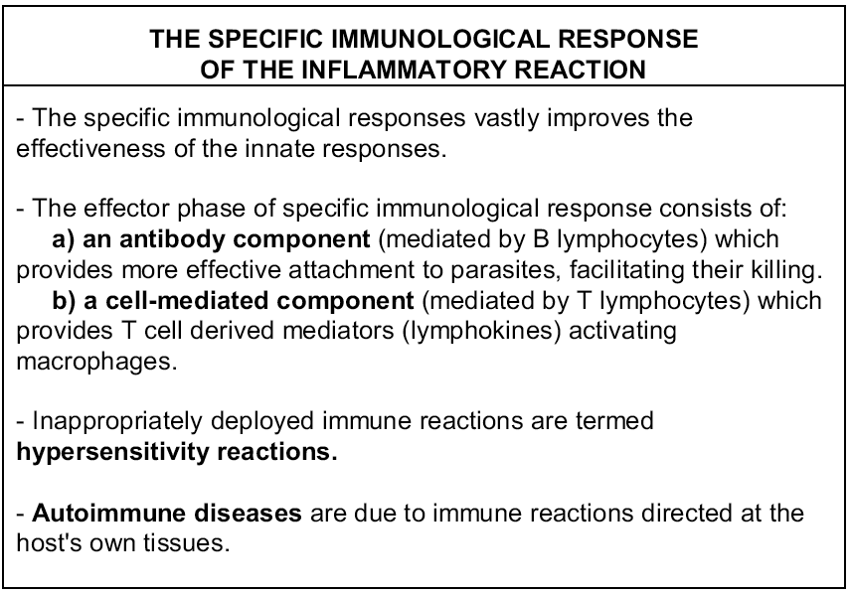

Slide 4
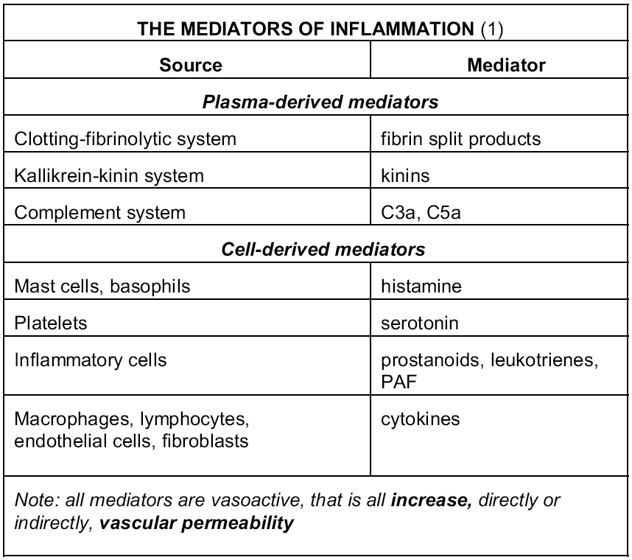

Slide 5
Medicinal Treatment for Arthritis
Pain Relief.
The most common medication used for acute pain relief are NSAIDs
Corticosteroid: mainly used for treatment of rheumatoid arthritis
NSAIDs have gastrointestinal side effects
We have already covered NSAIDs in the previous lecture
Notes:
Arthritis treatments are based upon the form or type of arthritis, severity, location and medical history of the patient.
Exercises Exercises are important for management of arthritis. It is always advisable to consult your doctor before starting the exercise program. You may also consult a physio therapist to guide you for the precautions and techniques to be followed for certain exercises. Moderate exercises are beneficial for arthritic patients. It eases joint pain and stiffness. There is muscle development around the joints which increases the flexibility of the joints. It keeps you fit and active. Exercises help reduce inflammation resulting from arthritis and prevent other chronic conditions. Always start with some slow exercises and do it with fun. Stretching exercises improves motion and helps performing daily activities.
Heat and Cold Therapy This treatment is effective for relieving pain, stiffness and swelling resulting from arthritis. Hot packs, hot water bottles or a damp warm towel is used for heat therapy. Heat treatment provides a soothing effect by relaxing your muscles. Cold therapy is done by applying ice packs over the affected joints. This should not exceed 15 minutes and a gap of 30 minutes is to be maintained between treatments.
Herbal Remedies
Angelica- This herb has essential components for arthritis treatment. The herb has proved effective for treatment of arthritis. Angelica has 10 muscle relaxant constituents, 5 pain relieving and 12 anti-inflammatory constituents.
Boswellia has anti-inflammatory properties, similar to non-steroidal anti-inflammatory drugs.
Black Cohosh has muscle relaxant and anti-inflammatory components which are helpful for pain relief.
Celery seeds dispels uric acid, hence is effective for gout and treatment for arthritis.
Sarasparilla is effective for rheumatoid arthritis treatment due to its anti-inflammatory properties.
Medications:
Mild pain relievers like acetaminophen and aspirin are prescribed as treatment for arthritis. Sufficient doses of acetominophen can be equally effective as anti-inflammatory drugs. Acetominophen has few gastrointestinal side effects compared to NSAIDs. Hence, it is generally prescribed as an initial drug for patients with osteoarthritis.
Application of pain relieving cream on the skin over the joints provides relief from minor arthritis pain. Some of the examples are Salycin, menthol, capsaicin and methyl salicylate.
Non-steroidal anti-inflammatory drugs (NSAIDs) - These drugs reduce inflammation. Examples of NSAIDs are Aspirin, ibuprofen, indomethician, nabumetone. The side effects of NSAIDs are heartburn, stomach upset and abdominal pain.
Corticosteroids- They are the drugs which act by reducing inflammation. Steroids can be given topically, orally or by injections. Steroids work by reducing the activity of immune system. Low doses of steroids are recommended by doctors. However in acute cases, higher dosage for a limited period may be recommended.
Steroids are used for treatment of rheumatoid arthritis. Repetitive injections of cortisone can be harmful for the bones and tissues. Hence it is reserved for patients with severe arthritis.
Surgery Patients with severe or acute arthritis and those unresponsive to other treatments can undergo a surgery. Surgical procedure aims at relieving pain and correcting the deformity or abnormality. Orthopedic surgeons are doctors specialized in joint surgery.
Arthroscopy: in this joint surgery, a thin viewing tube is introduced into the joint through a cut made on skin. This helps the surgeon find the damaged tissue and remove them.
Osteonomy: This is a bone removal process. This helps in the realignment of the deformity.
Arthoplasty is a surgical procedure which helps to replace the affected or diseased joint. Bones in the affected joint may be reshaped or replaced with plastic or metal parts. This helps in relieving pain and restoring function.
Total joint replacement is a surgical process to replace the destroyed joint with artificial materials. They help relieving pain and improving function.
Homeopathy Homeopathic medicines are safe to use with no side effects. It is advisable to take these medicines under the supervision and prescription of a homeopathic doctor. Some common homeopathic medications for arthritis include:
Bryonica- It is generally prescribed when the patient experiences pain on the affected joints during joint movements.
Causticum- It is used when stiffness is experienced in the affected joint.
Belladona- Generally prescribed when inflammation and redness is observed in the affected joints.
Pulsatilla- Used when the pain is not persisting on one joint and shifts from one joint to other.
Hip Arthritis Treatments
Psoriatic Treatment
Finger Treatment
Fibromyalgia Treatment
Osteoarthritis Treatment
Rheumatoid Treatment
Vitamins for Arthritis
Home Remedies for Arthritis
Acupuncture Treatment for Arthritis
Wrist Treatment
Knee Treatment
Treatment for Hip Osteoarthritis
Treatment for Ankle Osteoarthritis
Treatment for Cervical Osteoarthritis
Treatment for Shoulder Osteoarthritis
Arthritis Diet Treatment
Rheumatoid Arthritis Hands Treatment
Treatment for Spinal Osteoarthritis
Foot and Ankle Treatment
Elbow Treatment
Neck Treatment
Thumb Treatment
Hand Treatment
Arthritis Exercises
Treatment for Hand Osteoarthritis
Treatment for Wrist Osteoarthritis
Treatment for Foot Osteoarthritis
Juvenile Rheumatoid Treatment
Hip Rheumatoid Treatment
Osteoarthritis Exercise
Osteoarthritis Diet
Treatment for Finger Osteoarthritis
Foot Rheumatoid Arthritis
Herbal Remedies for Arthritis
Rheumatoid Arthritis Diet
Shoulder TreatmentTreatment for Thumb Osteoarthritis
Treatment for Corns
Treatment for Cramp
Treatment for Leg Cramps
Treatment for Rotator Cuff
Treatment for Torn Rotator Cuff
Treatment for Bulging Disc
Treatment for Ruptured Disc
Treatment for Slipped Disc
Treatment for Bursitis
Treatment for Diverticulitis
Treatment for Fracture
Treatment for Rotator Cuff Injury
Treatment for Sciatic Nerve
Treatment for Spinal Cord Injury
Treatment for Whiplash and Neck Injury
Treatment of Knee Osteoarthritis
Treatment of Osteomyelitis
Treatment of Osteoporosis
Treatment for Spinal Stenosis
Treatment for Tetanus
Treatment of Sprains
Treatment of Tendonitis
Treatment for Dislocated Shoulder
Treatment for Sciatica
Treatment for Ankle Sprain
Treatment for Ankylosing Spondylitis
Treatment for Cervical Spondylosis
Treatment for Sprains
Treatment for Whiplash
Treatment for Achilles Tendonitis
Treatment for Carpal Tunnel
Treatment for Osteoarthritis of the Knee
Treatment for Water on the Knee

Slide 9
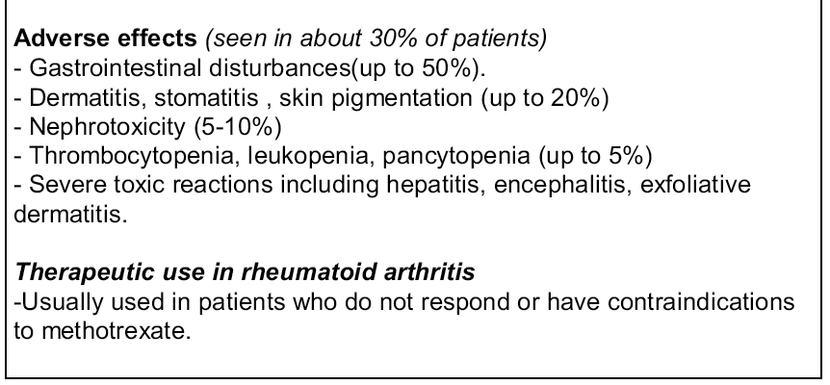
Auranofin: 3 mg once a day for 2 weeks. Increase to 6 mg each day. 3-4 months
Aurothioglucose: 10 mg followed by 25 mg for the second and third doses, then 50 mg weekly until 0.8 to 1 g has been administered

Slide 11
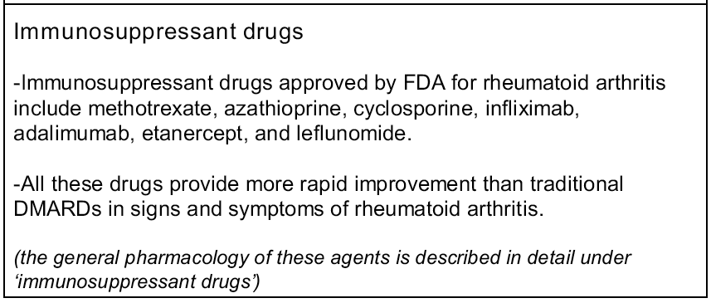

Slide 14
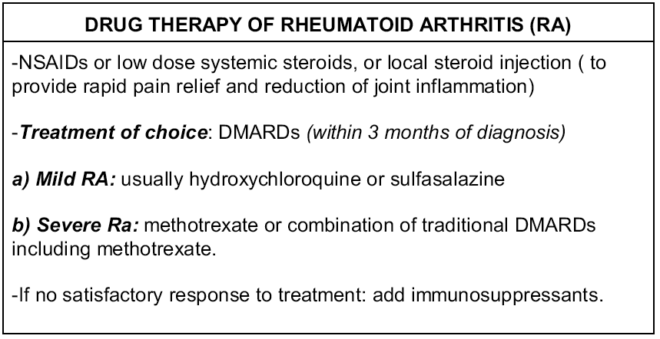

Slide 15
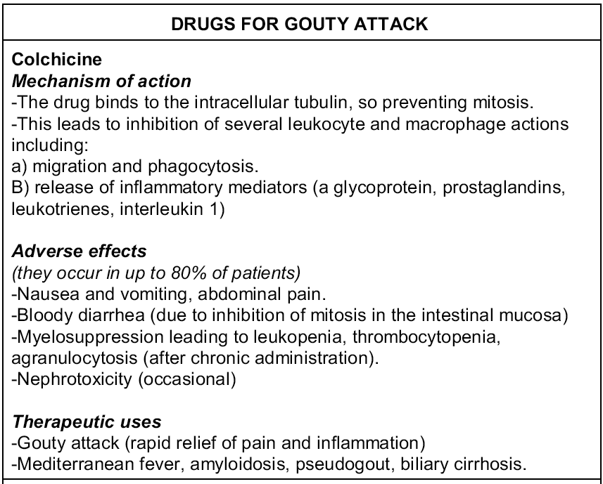
See notes below this slide for pathophysiology of Gout.
Notes:
PATHOPHYSIOLOGY OF GOUT
-Gout is a recurrent acute or chronic arthritis of peripheral joints that
results from deposition of monosodium urate crystals from
supersaturated hyperuricemic body fluids.
-Plasma uric acid levels are usually kept within a relatively narrow
range (4.0-8.5 mg/dL).
-When plasma levels of urate are saturated crystals are formed and
deposited in the synovial fluid of joints.
-These crystals trigger an acute inflammatory response with formation
of interleukin-1, activation of complement and plasmin cascade
systems, and generation of prostaglandins and leukotrienes.
-Leukocytes engulf crystals by phagocytosis resulting in generation of
tissue-damaging free radicals and release of proteolytic enzymes.
-The resulting inflammation cause a sudden onset of excruciating joint
pain associated with localized hyperemia, warmth and tenderness.
-Gout affect about 25% of the population of Europe and North America.
-Even if there is a positive association between gout and
hyperuricemia, many hyperuricemic patients do not suffer from gout and
gout attacks have occurred in patients with normal uric acid plasma
levels.

Slide 16
Acute Gouty Attack
Remember: FOR PAIN RELIEF NSAIDs SHOULD BE PRESCRIBED (also see colchicine)

Slide 18
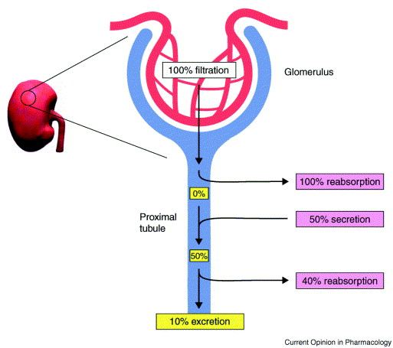

Slide 19
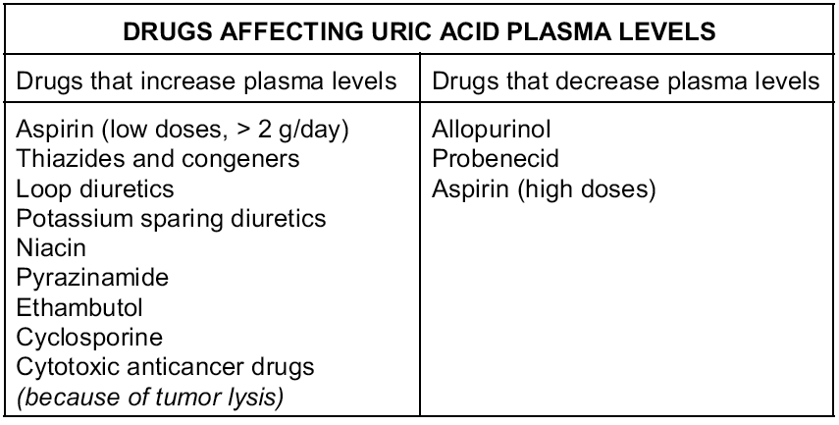

Slide 20
Drugs for Hyperuricemia

Slide 21
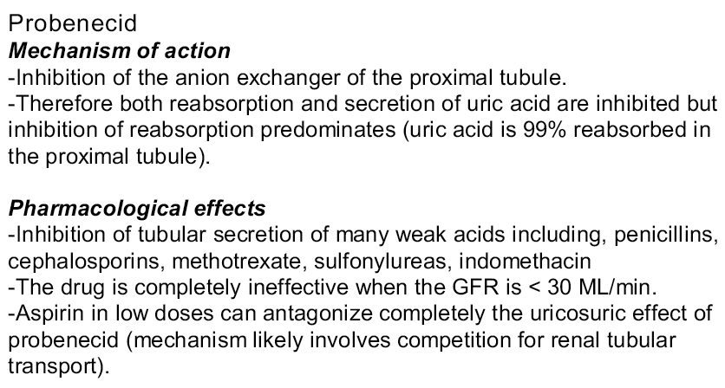

Slide 23
