Slide 1
Diseases of musculoskeletal system
By
Dr. Abdelaty Shawky Dr. Gehan Abdel monem

Slide 2
Topics
Developmental disorders of musculoskeletal system.
Infectious diseases of bone and joints.
Metabolic bone diseases.
Degenerative bone diseases.
Neoplastic bone diseases.

Slide 3
1. Developmental disorders of musculoskeletal system
Congenital hip dislocation.
Duchenne muscular dystrophy.
Osteogenesis imperfecta.
D. Limb Anomalies
Amelia, Meromelia
Polydactyly
Syndactyly

Slide 4
ILOs
Identifying the definition and etiology of congenital hip dislocation.
Identifying pathological features of Duchenne muscular dystrophy.
Understanding etiology, Clinical manifestations of osteogenesis imperfecta.
Recognizing etiology, epidemiology, pathological features and complications of paget's disease of bone.

Slide 5
A. Congenital hip dislocation (developmental hip dysplasia)

Slide 6
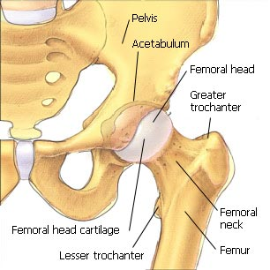
Normal anatomy of the hip joint

Slide 7
A disorder of unknown cause in which the head of the femur is displaced from its socket in the acetabulum.
It is generally recognized at birth.
The disorder is familial, more common in females than in males.
If untreated, a false socket develops, and the individual later walks with a severe limp.
* Treatment: consists in reduction of the dislocation and the use of splints to keep the femur in the socket until the joint ligaments adapt to the new position.

Slide 8
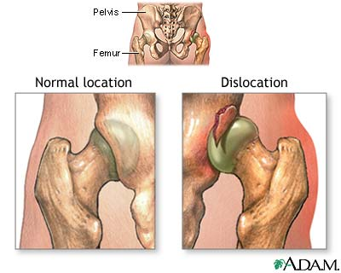

Slide 9
B. Duchenne muscular dystrophy

Slide 10
Duchenne muscular dystrophy (DMD) is a form of muscular dystrophy which results in muscle degeneration and eventual death.
* Etiology: The disorder is caused by a mutation in the dystrophin gene, located on the human X chromosome, which codes for the protein dystrophin, an important structural component within muscle tissue that provides structural stability to the dystroglycan complex (DGC) of the cell membrane.
* Symptoms:
Progressive proximal muscle weakness of the legs and pelvis associated with a loss of muscle mass is observed first. Eventually this weakness spreads to the arms, neck, and other areas.
Due to progressive deterioration of muscle, loss of movement occurs, eventually leading to paralysis.

Slide 11
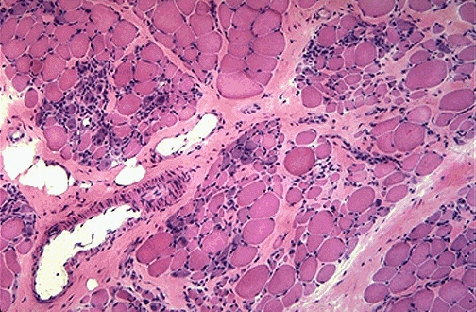
* Histopathology: There is degeneration of muscle fibers along with some regeneration and scattered chronic inflammatory cells, fibrosis, and hypertrophy of remaining muscle fibers.

Slide 12
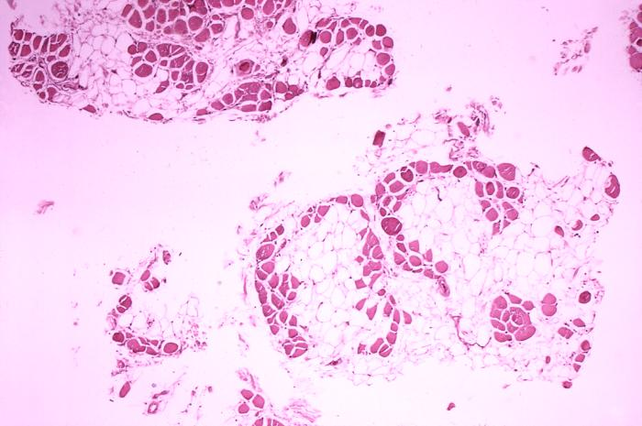
Replacement of the damaged muscle fibers by fat

Slide 13
* Treatment:
There is no known cure for Duchenne muscular dystrophy. Treatment aims to control symptoms to maximize quality of life. Gene therapy may become available in the future.
Activity is encouraged. Inactivity (such as bed rest) can worsen the muscle disease. Physical therapy may be helpful to maintain muscle strength and function. Orthopedic appliances (such as braces and wheelchairs) may improve mobility and the ability to care for yourself.

Slide 14
C. Osteogenesis imperfecta

Slide 15
Osteogenesis imperfecta (OI), also known as Brittle Bone Disease, is a heritable disorder of connective tissue.
* Etiology: an autosomal dominant disorder of type I collagen, the major protein component in the extracellular matrix of bone.
* Clinical features:
Bone fragility, with a tendency to fracture from minimal trauma.
Short stature, macrocephaly, blue sclera, dentinogenesis imperfecta, hearing loss and neurological and pulmonary complications.
* Morphologically: too little bone with marked cortical thinning and attenuation of trabeculae.

Slide 16
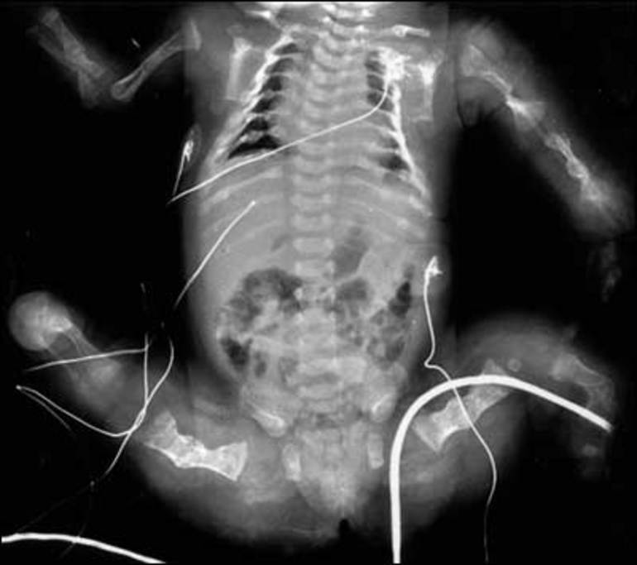

Slide 17
D. Limb anomalies

Slide 18
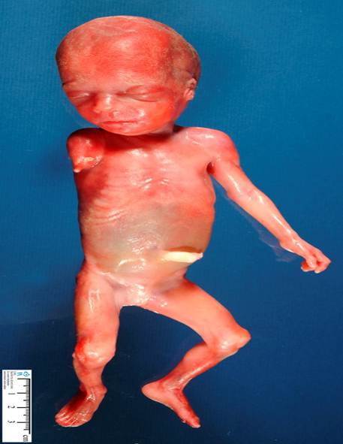
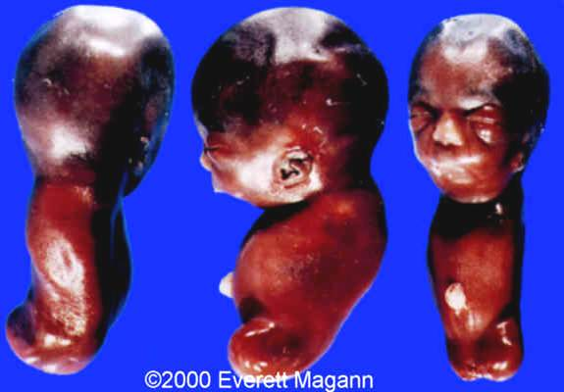
Amelia:
complete Absence of one or more limbs

Slide 19
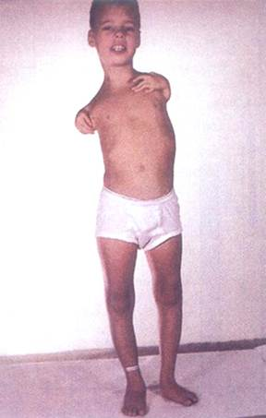
Meromelia
Partial absence of a limb or limbs

Slide 20
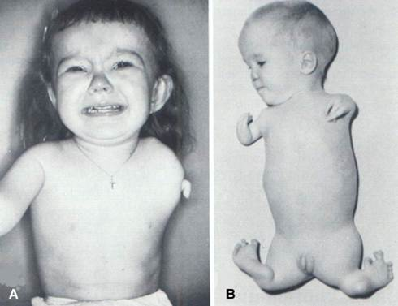
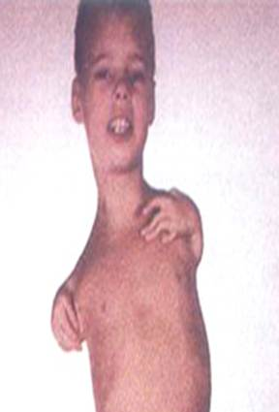
Phocomelia
Extremities resemble those of a seal.
Typically, hands and feet are present (may be normal or abnormal), but the intervening arms and legs are absent

Slide 21
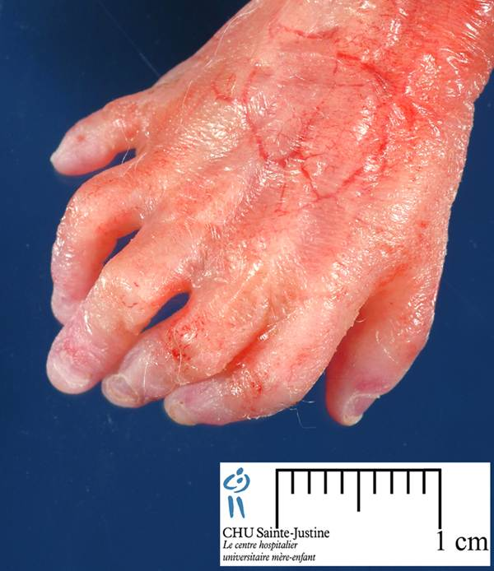
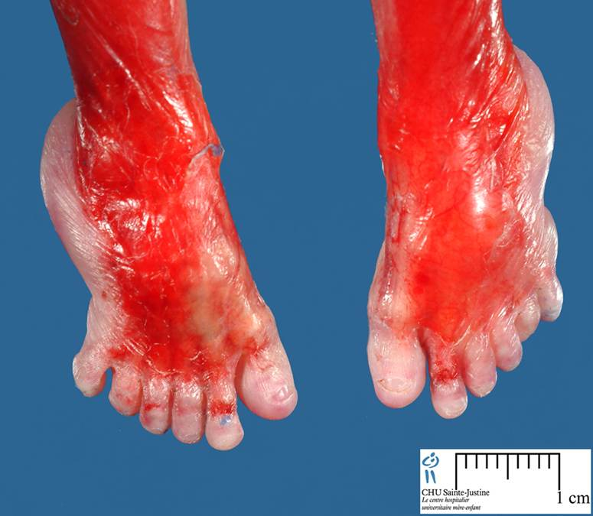
Polydactyly
Poly: many, dactyl: digit (finger/toe)
Presence of more than normal number of fingers or toes

Slide 22
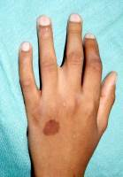
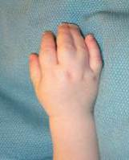
Syndactyly

Slide 23
Absent thumb

Slide 24
Thanks

