Slide 1
Histology
Histology is the study of the tissues of the body and how these tissues are arranged to constitute organs
Literally, histology means tissue or web
To study tissues, certain techniques an instruments are used to study tissues

Slide 2
Tissue Preparation
For conventional bright field light microscopy, we follow the following steps:
Fixation:
0.5 X0.5 cm tissue is added to a small jar containing the fixative to:
Prevent autolysis
Terminate cell metabolism
Kill bacteria
Harden tissue
The fixative used is usually Formalin 10% solution

Slide 3
Tissue Preparation
2. Dehydration:
Ascending grades of alcohol are used to take water out of the specimen.
3. Clearing:
To clear the sample using solution miscible in alcohol and embedding medium. Solution used is Xylene

Slide 4
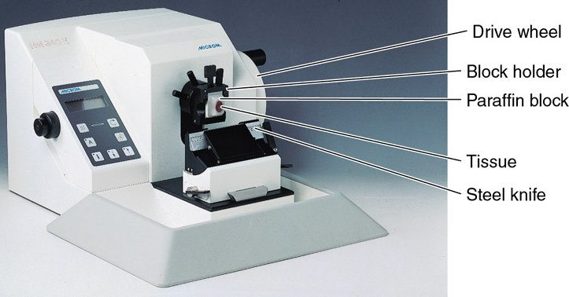
Tissue Preparation
4. Embedding:
Putting the specimen in embedding medium (Paraffin) to enable us to cut the sections
5. Cutting:
Cutting thin sections
(5µm) by a microtome
using steel knife
6. Mounting:
Putting the section on
a glass slide using adhesive material (Egg albumin)

Slide 5
Staining the Slide
Sections must pass through many steps before they are stained and be visualized in the light microscope
Principles of staining:
Staining is to impart colors to different tissue components.
Staining is a reaction between stain and tissue component

Slide 6
Staining the Slide
Stains are either positively or negatively charged
Tissue components also are negatively and positively charged
Basic dyes (Hematoxylene) are bound to negatively charged tissue components
Acidic dyes (Eosin) are bound to positively charged tissue components

Slide 7
Basic dyes stain:
Heterochromatin
Nucleic acids
Ribosomes
Cartilage
Acidic dyes stain:
Filaments
Mitochondria
Collagen
Muscle fibers

Slide 8
Additional Dyes
Many tissue components can not be stained with (Hematoxylene and Eosin).
Other dyes are used to specifically stain certain tissue components
Resorcin-Fuchsin for elastic fibers
Silver stain for reticular fibers and basement membrane
Periodic-Acid Schiff (PAS) Reaction for CHO

Slide 9
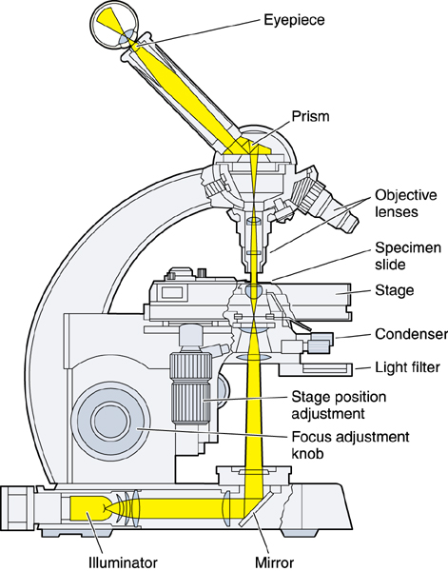
Visualizing Slides
Bright field microscope is used to visualize specimens on glass slides
The resolution of the light
microscope is 0.2µm
Resolution is defined as( The
smallest distance between
2 points can be seen as 2
points)

Slide 10
Resolution
Human Eye
Light microscope
Electron microscope
Atomic force microscope
0.2mm
0.2µm
0.2nm
0.05nm

Slide 11
Study Techniques
Microscopy
Bright Field Microscopy
Dark field Microscopy
Electron Microscopy (Transmission and Scanning)
Fluorescent microscopy
Confocal microscopy
Atomic force microscopy
Histochemistry and Cytochemistry
Immunocytochemistry and Hybridization
Autoradiography

Slide 12
Fixation
Dehydration
Clearing
Embedding
Cutting
Knife
Mounting
Staining
Viewing
Fomalin
Ethyle alcohol
Xylene
Paraffin
Microtome
Steel knife
Glass slide
H&E
Light microscope
Glutaraldehyde
Acetone
Propylene oxide
Epoxy resin
Ultramicrotome
Diamond knife
Metal grid
Uranyl acetate
Electron microscope

Slide 13
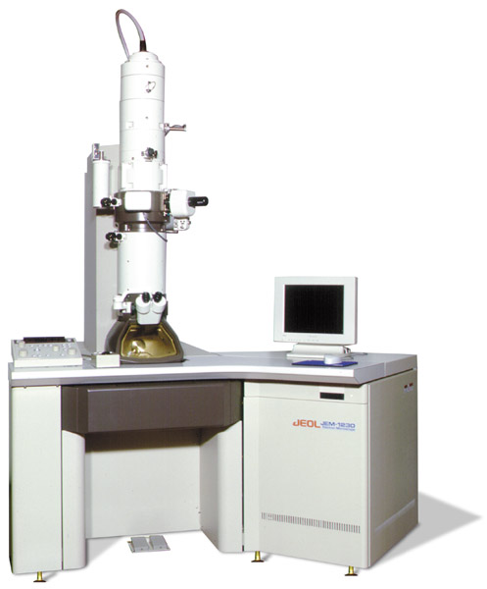
a

Slide 14
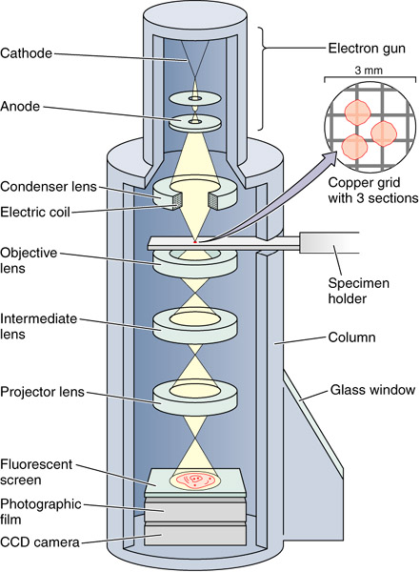

Slide 15
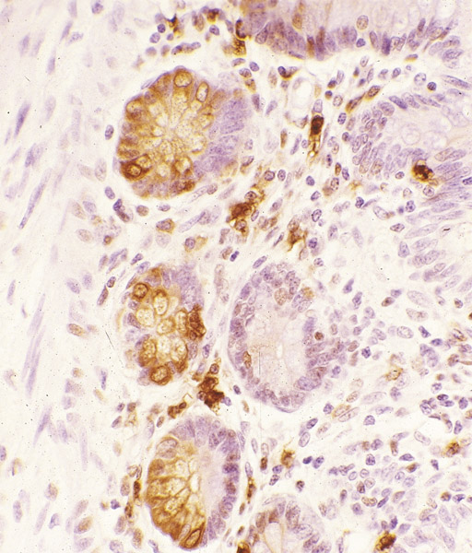

Slide 16
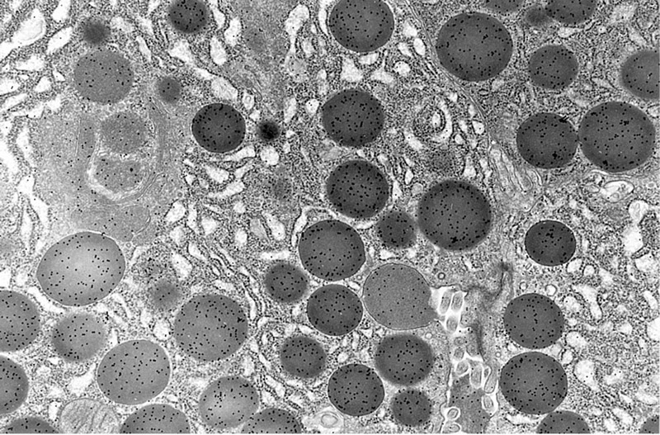
a

Slide 17
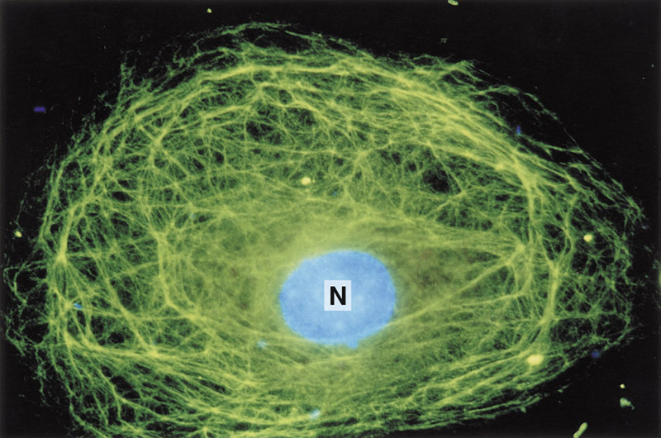
a

