Slide 1
GAS EXCHANGE (Lecture 5)

Slide 2
The ultimate aim of breathing is to provide a continuous supply of fresh O2 by the blood and to constantly remove CO2 from the blood.
Blood acts as a transport system
for O2 and CO2 between the lungs and tissues, with the tissue cells extracting O2 from the blood and eliminating CO2 into it.

Slide 3
Partial pressures
Gases move down along partial pressure gradients.
Gas exchange at both the pulmonary capillary and the tissue capillary levels involves simple passive diffusion of O2 and CO2 down partial pressure gradients.
No active transport mechanisms exist for these gases.

Slide 4
What is partial pressure?
The individual pressure exerted independently by a particular gas within a mixture of gases is known as it’s partial pressure, designated by Pgas,
e.g. (PO2, PCO2).

Slide 5
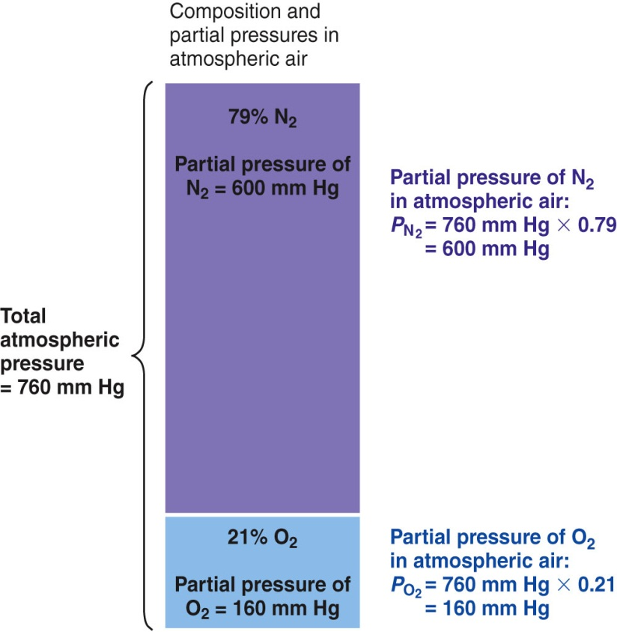
At both pulmonary capillary and tissue capillary levels, gas exchange involves simple diffusion of O₂ and CO₂ down partial pressure gradients
Partial pressure exerted by each gas in a mixture equals the total pressure times the fractional composition of this gas in the mixture

Slide 6
Thus, the partial pressure of O2 in atmospheric air (PO2), is normally 160 mm Hg.
The atmospheric partial pressure of CO2 (PCO2), is negligible at 0.23 mm Hg.

Slide 7
Partial Pressures of Gases in Inspired Air and Alveolar Air

Slide 8
Alveolar air | Inspired air
47 mmHg | Variable | H2O
40 mmHg | 0.23 mmHg | CO2
100 mmHg | 160 mmHg | O2
573 mmHg | 600 mmHg | N2
760 mmHg | 760 mmHg | Total pressure

Slide 9
Partial Pressures of Gases in Inspired Air and Alveolar Air
Insert fig. 16.20

Slide 10
: PARTIAL PRESSURE GRADIENT
Partial pressure gradient:
A difference in partial pressure between capillary blood and surrounding structures is known as a partial pressure gradient.
Partial pressure gradients exist between the alveolar air and pulmonary capillary blood. Similarly partial pressure gradients exist between systemic capillary blood and surrounding tissues.
A gas always diffuses down its partial pressure gradient from the area of higher partial pressure to the area of lower partial pressure, similar to diffusion down a concentration gradient.

Slide 11
Gas Exchange
Exchange across systemic capillaries occurs down partial pressure gradients
By equilibration in the alveoli, the oxygen in the systemic capillaries has a high partial pressure (e.g.,100mmHg) compared to tissue cells,
(e.g.,40mmHg). These cells are using oxygen.
The partial pressure for carbon dioxide in the systemic capillaries is low (e.g.,40mmHg) compared to the tissue cells (e.g.,46mmHg), which are making this gas through their metabolism.

Slide 12
By partial pressure gradients:
Oxygen diffuses from the systemic capillaries into the tissue cells (100 to 40mmHg, higher to lower).
Carbon dioxide diffuses in the opposite direction from tissues to capillaries (46 to 40mmHg).
Having equilibrated with the tissue cells, the blood leaving the systemic capillaries is low in oxygen and high in carbon dioxide.
This blood returns to the right side of the heart and on to the lungs. At the pulmonary capillaries, the blood acquires oxygen and releases some of its carbon dioxide.

Slide 13
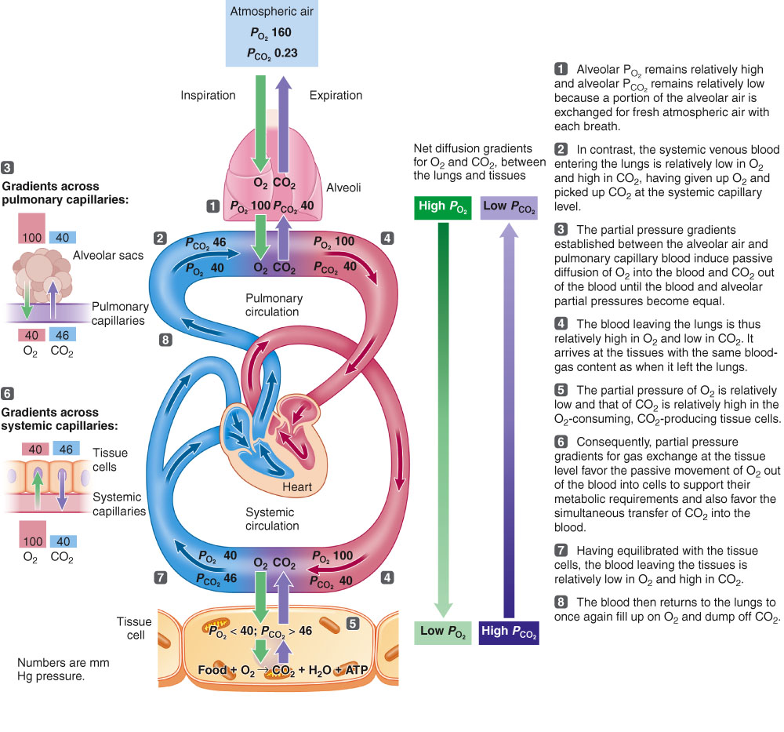
Oxygen and Carbon Dioxide Exchange Across Pulmonary and Systemic Capillaries Caused by Partial Pressure Gradients

Slide 14
Gas Exchange Contd.
Additional factors that affect the rate of gas transfer across alveolar membrane:
As surface area increases, the rate increases
Increase in thickness of barrier separating air and blood decreases rate of gas transfer
Rate of gas exchange is directly proportional to the diffusion coefficient for a gas
Partial pressure gradients of Oxygen and Carbon Dioxide
Diffusion Constant

Slide 16
Pathological factors affecting Gas exchange

Slide 17
Pathological conditions reducing pulmonary surface area:
(1) Emphysema (surface area is reduced ,
because many alveolar walls are lost),
(2) Collapsed regions of the lung
(3) When part of the lung tissue
is surgically removed—(for example,
in treating lung cancer).

Slide 18
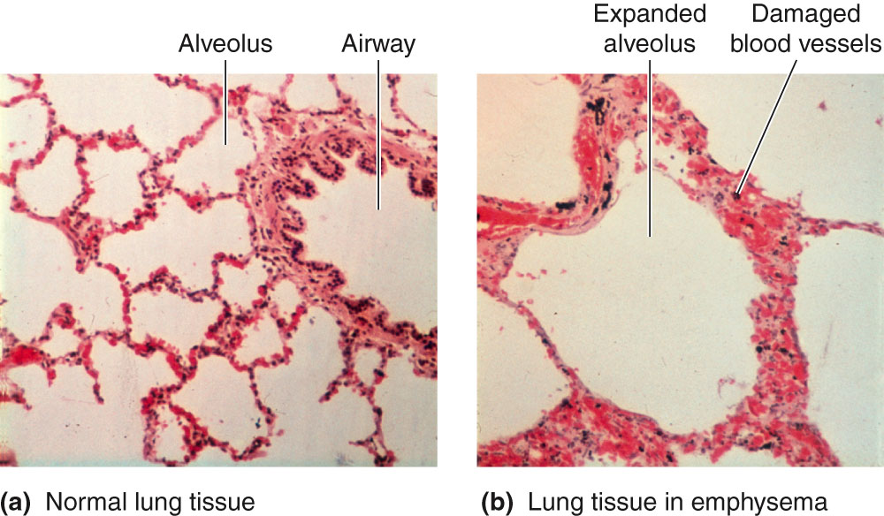

Slide 19
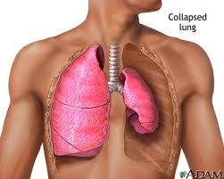

Slide 20
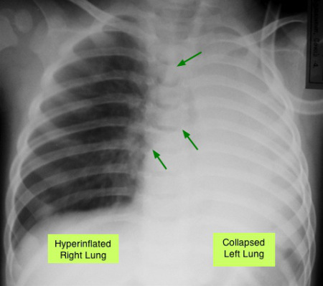

Slide 21
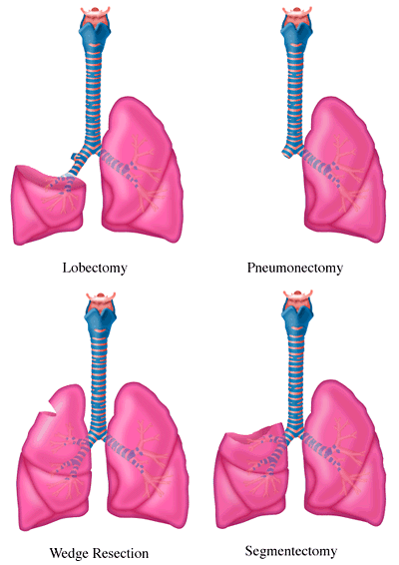

Slide 22
EFFECT OF THICKNESS ON GAS EXCHANGE:
The thickness increases in,
Pulmonary edema
an excess accumulation of interstitial fluid
(2) Pulmonary fibrosis involving replacement of
delicate lung tissue with thick, fibrous tissue
(3) Pneumonia, which is characterized by
inflammatory fluid accumulation within or
around the alveoli.

Slide 24
In a diseased lung in which diffusion is impeded because
the surface area is decreased or the blood–air
barrier is thickened,
O2 transfer is usually more seriously impaired than CO2 transfer because of the larger CO2 diffusion constant.
In milder conditions, diffusion of both O2 and CO2 might remain adequate at rest.
During exercise, when pulmonary transit time is decreased, the blood gases, especially O2, may not have
completely equilibrated with the alveolar gases before the blood leaves the lungs.

Slide 25
Things to be learn from this lecture
What is partial pressure?
What is partial pressure of different gases?
What is partial pressure gradient?
Gas exchange across systemic and pulmonary capillaries
Gas exchange across alveoli & pulmonary Capillaries and systemic capillaries & tissues
Factors affecting gas exchange
Pathological conditions affecting gas exchange

