Slide 1
Foodborne diseases:
In 2010, Public health workers (Foodborne diseases active surveillance Network (Food-Net)) estimate approx. 1000 outbreaks, 48 million illnesses, 128,000 hospitalization, and 3000 deaths annually due to foodborne illness in USA.
Definitions:
Food poisoning: gastrointestinal illness caused by consumption of food contaminated with bacteria, toxins,
Fungi, toxins, parasites, viruses or chemicals.

Slide 2
N
Foodborne disease outbreak:
Gastrointestinal illness of two or more persons who experience similar symptoms due to ingestion of contaminated food or water confirmed by epidemiological analysis results.
Types of Food poisoning:
1- Intoxication: ingestion of food contaminated by
microbial toxins.
Caused by: Staphylococcus aureus, Clostridium
perfringens, Clostridium botulinum,
Bacillus cereus.

Slide 3
N
Intoxication is mainly characterized by short incubation period, upper gastrointestinal symptoms such as nausea and vomiting.
2- Food poisoning caused by microbial entry:
Due to ingestion of food contaminated by microbes or
microbes and their toxins.
Caused by Vibrio species, ETEC, EPEC, Salmonella,
Campylobacter, and others.
This type is mainly characterized by longer incubation
period, fever, and lower gastrointestinal symptoms.

Slide 4
Types of foodborne Intoxication:
Staphylococcus aureus toxigenic disease:
Implicated food:
Carbohydrate rich food: Cake, Pasta, Potato, Salads.
Protein rich food: Beef or Pork-meat, Mayonnaise, Milk and its products (e.g. ice-cream).
Source of food contamination:
- Usually a carrier persons such as food-handlers.
- The organism grows in the food and produces the toxin.
Incubation period: Very short (1 – 6 hours)
Symptoms:
Appear during 6 hours (epidemiological clue) :
Vomiting, nausea and diarrhea but no fever.
Duration of illness: 24 – 48 hrs (self limited).

Slide 5
N
Enterotoxins:
1-Enterotoxins: A, B, C, D, E, and G.
-Produced by 65% of Staphylococcus aureus.
-Heat-stable (resist ~30 minutes of boiling 100ᵒC).
-Resistant to hydrolysis by gastric proteases.
-Do not change the characters of food (taste, color, or odor).
-Enterotoxin A is the most common type.
-Enterotoxin C and D are associated with contaminated
milk.
-Toxins cause Watery diarrhea; could cause dehydration
-Enterotoxin B is associated with Staphylococcus
Pseudomembrance Enterocolitis.

Slide 6
N
2-Enterotoxin F and pyrogenic exotoxin c:
(Toxic-Shock Syndrome toxin-1):
-Mainly produced during Staphylococcus aureus growth
inside the GIT.
-If released in bloodstream, these toxins will cause sepsis
, septic shock, and MODS.
Diagnosis:
-Vomiting, nausea, abdominal cramps, followed by
diarrhea.
-Abdominal pain or inflammation are absent.
-History of eating meats of high salt content.

Slide 7
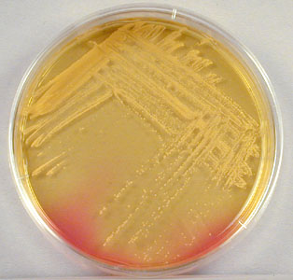
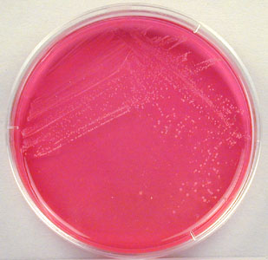
N
-History of ingesting food with high sugar content may be
helpful.
-Laboratory diagnosis:
Specimens: Swabs from vomitus, implicated food, Skin of
food-handler, Nasal swabs of carriers.
-Phage typing.
-Biotyping.

Slide 8
Clostridium perfringens intoxication:
Implicated food: Poultry, meat, Pork-meat.
-Cooked-meat that not-refrigerated could carry microbial
spores; spore germination due to exposure to gastric
acid; toxin production.
-Types of Toxins:
1-Enterotoxin: Heat-labile:
-Maximal activity in ileum.
-Inhibits glucose and ions transport; damage of
intestinal epithelial cells; loss of protein.
-It can be detected in stool, and anti-toxin antibodies
present in patient serum.

Slide 9
N
Effect: Watery diarrhea without nausea or vomiting
2- Exotoxins:
-Alpha-toxin ;(lecithinase).
-Heat-stable.
-Effect:
-Disease: Enteritis necroticans.
-Damage of phospholipids in mammalian cell membrane
causing erythrocyte ,leukocytes, endothelial cells, and
platelets lysis.
- Intestinal necrosis with bloody diarrhea.
- If the toxin released in bloodstream; sepsis and septic
shock; Mortality rate: 40%.

Slide 10
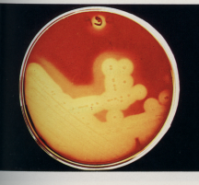
N
Diagnosis of Clostridium perfringens intoxication:
Enteritis necroticans:
-Intestinal necrosis with bloody diarrhea.
-Negative stool culture.
-Positive antibodies in serum in 65-85% of patients.
Watery diarrhea:
-Positive culture from stool
specimens and implicated
food samples;
10⁵ CFU/gm is a diagnostic
feature. Zone of Beta-hemolysis surrounded by
wider zone of alpha-hemolysis.

Slide 11
Clostridium botulinum intoxication: Botulism:
Implicated food:
-Canned food, sausage, canned salmon and salted fish.
-Type of Toxin:
-Botulinum toxin A,B,C,….G.
-Heat-labile (10 minutes at 60 ᵒC).
-Polypeptide Neurotoxin.
-Two subunits: light-A chain: Neurotoxin.
heavy-B chain: Protects the toxin from stomach acidity
-The toxin is protected from gastric enzyme by large content
of protein in the meal.
-Incubation period: 12-72 hours.

Slide 12
N
Effect of botulinum toxin:
-After absorption, circulating neurotoxins affect
Cholinergic nerves function:
-Effect on sympathetic nervous system:
Blocking of excitatory acetylcholine release in
neurotransmitter junction;
bilateral descending flaccid paralysis.
-Effect on Cranial nerve function: blurred vision, fixed
dilated pupils.
-Effect on parasympathetic nervous system:
Respiratory paralysis; death.

Slide 13
Effect of botulinum toxin:
N

Slide 14
N
Management:
-Adequate ventilation support.
-Gastric Lavage and Penicillin therapy.
-Trivalent botulinum antitoxin vaccination.
Prevention:
-Good heating of food to destroy toxin.
-Storage of food at 4C.

Slide 15
Bacillus cereus intoxication:
1-Emetic syndrome: Heat-stable enterotoxins.
-Associated foods:
-Consumption of toxin in boiled or fried rice.
-Carbohydrates rich food.
-Incubation period:
Short incubation period of 1-6 hours
-Clinical presentation:
Upper gastrointestinal symptoms such as nausea, vomiting
and abdominal cramps.
-Duration of illness: 6-10 hour.

Slide 16
N
2- Diarrheal syndrome: Heat-Labile enterotoxins.
(Stimulate adenylate cyclase-cAMP system).
- Associated foods: consumption of contaminated meat
products, soups, sauces, and vegetables.
- Incubation period: Long incubation period of 8-16 hours.
- Symptoms and signs:
Watery diarrhea, abdominal cramps and occasional nausea
& vomiting.
-Duration of illness: 24-48 hours.

Slide 17
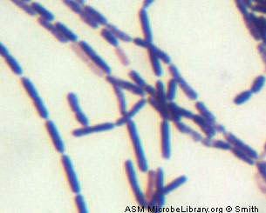
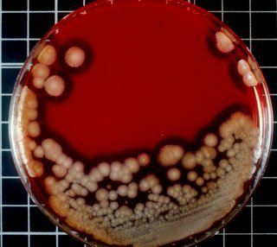
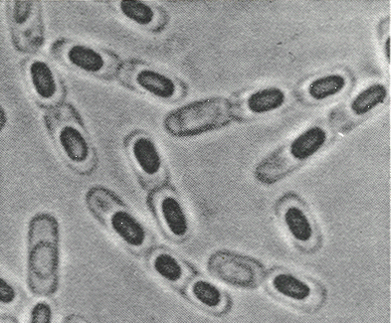
N
Diagnosis:
-Isolation of microbes from clinical specimens and food
samples(same species identification).
-Phage typing.
-Biotyping.

Slide 18
Fungal Intoxication: Mycotoxicosis:
Toxins:
1-Aflatoxins B1,B2, G1,G2:
-Produced by Aspergillus flavus.
-Implicated food: Peanuts, Corn, grains.
-Effect: liver necrosis, hepatocarcinogen.
2-Ergot alkaloids:
-Produced by Claviceps purpurea.
-Implicated food: wheat, corn, rice.
-Effect: Arterial and venous vasoconstriction.
Endothelial cell damage.

Slide 19
N
3-Tricothecene:
-Produced by Fusarium species.
-Implicated food: Corn, rice, wheat.
-Effect: inhibition of DNA replication and mRNA
transcription in the epithelial lining of
GIT and bone marrow.
4-Ochratoxins A,B,C:
-Produced by Aspergillus species. Food: Corn, rice.
-Effect: Destruction of proximal tubules of kidney;
decreased electrolytes absorption,
increased water excretion.

