Slide 1
Apraoche to headache
Dr. Hossam Hassan

Slide 2
46-year-old female with a history of migraine headaches who presents with a severe, constant pain that started suddenly while running. She admits this “feels different than my normal headaches.” On examination, she appears ill and is vomiting. Her neurologic examination demonstrates mild neck stiffness. She asks for a refill of her sumatriptan, which “always works for my headaches.”

Slide 3
27-year-old “frequent flyer.” She describes her typical migraine headache, not controlled with home medications. Her vital signs and examination are unremarkable. You would like to treat her quickly and effectively, knowing that, if you do not, she will make the rest of your day difficult.

Slide 4
Classification Of Headaches
Headaches are commonly classified into 2 groups: (1) primary headache disorders, where the etiology is unknown, and (2) secondary headache disorders, where the headache is attributed to a specific underlying cause.

Slide 5
Primary headache disorders are further subdivided into 4 categories: (1) tension-type, (2) migraine, (3) cluster, and (4) other.

Slide 6
Tension-Type Headaches
Tension-type headaches are defined as having 2 of the following characteristics: bilateral location, nonpulsating quality of pain, mild to moderate intensity, and not aggravated by physical activity.

Slide 7
Migraine Headaches
Adult women suffer migraines more frequently than men (3:1)
According to the ICHD-2, migraines are typically unilateral, pounding, moderate to severe pain, worse with exercise, and often associated with nausea, vomiting, photophobia, or phonophobia.

Slide 8
Migraines are generally subdivided into aura types and non-aura types, the ICHD-2 lists over 20 specific subtypes of migraine.

Slide 9
Cluster Headaches
Cluster headaches are defined as severe, frequent headaches with parasympathetic autonomic features including injected sclera, lacrimation, rhinorrhea, facial sweating, and eyelid swelling. Pain is often so severe that patients “are usually unable to lie down.

Slide 10
Other Primary Headaches
The fourth category of primary headaches encompasses a wide range of diagnoses including primary cough headache, exertional headache, headache associated with sexual activity, and thunderclap headache.

Slide 11
Differential Diagnosis
The priority of emergency clinicians is not to diagnose primary headache disorders, but rather to rule out or treat secondary causes of headaches that pose an immediate threat to the lives and welfare of patients.

Slide 12
Tension-Type Headache
1. At least 10 episodes of headache attacks lasting from 30 minutes to 7 days
2. At least 2 of the following criteria:Pressing/tightening (nonpulsatile) quality
Mild or moderate intensity (may inhibit but does not prohibit activity)
Bilateral location
No aggravation by walking, stairs, or similar routine physical activity
3. Both of the following:No nausea or vomiting (anorexia may occur)
Photophobia and phonophobia are absent, or one but not both are present

Slide 13
Migraine Without Aura
1. At least 5 headache attacks lasting 4 to 72 hours (untreated or unsuccessfully treated), which have at least 2 of the 4 following characteristics:Unilateral location
Pulsating quality
Moderate or severe intensity (inhibits or prohibits daily activities)
Aggravated by walking, stairs, or similar routine physical activity
2. During headache, at least 1 of the 2 following symptoms occur:Phonophobia and photophobia
Nausea and/or vomiting

Slide 14
Migraine Without Aura
1. At least 5 headache attacks lasting 4 to 72 hours (untreated or unsuccessfully treated), which have at least 2 of the 4 following characteristics:Unilateral location
Pulsating quality
Moderate or severe intensity (inhibits or prohibits daily activities)
Aggravated by walking, stairs, or similar routine physical activity
2. During headache, at least 1 of the 2 following symptoms occur:Phonophobia and photophobia
Nausea and/or vomiting

Slide 15
Cluster Headache
At least 5 attacks of severe unilateral orbital, supraorbital, and/or temporal pain lasting 15 to 180 minutes untreated, with 1 or more of the following signs occurring on the same side as the pain:
Conjunctival injection
Lacrimation
Nasal congestion
Rhinorrhea
Forehead and facial sweating
Miosis
Ptosis
Eyelid edema
2. Frequency of attacks is from 1 every other day to 8 per day

Slide 16
Other Primary Headaches
Includes:
Primary exertional headache
Hypnic headache
Primary thunderclap headache
Primary headache associated with sexual activity

Slide 17
Secondary Headache Causes And red flag
Intracerebral tumor
Chronic progressive headaches, papilledema, history of malignancy
Cerebellar infarction
Ataxia, dysmetria, vertigo, vomiting
Idiopathic intracranial hypertension
Papilledema, worse when lying flat, obesity
Pituitary apoplexy
Hypotension, hypoglycemia, hyponatremia, visual field deficit, history of pituitary tumor
Pre-eclampsia
Hypertension, proteinuria, nondependent
Edema, pregnency

Slide 18
Secondary Headache Causes And red flag
Hypertensive encephalopathy
Altered mental status, hypertensive, neurologic signs in nonanatomic distribution
Subdural hematom
Trauma, coagulopathy
Intracerebral hemorrhage
Hypertension, cerebral aneurysm, arteriovenous malformation

Slide 19
Secondary Headache Causes And red flag
Subarachnoid Hge
Thunderclap (sudden, severe onset) headache
Meningitis
Fever, neck stiffness, immunosuppression
Temporal arteritis
Jaw claudication, vision changes, polymyalgia rheumatica
Carbon monoxide poisoning
Waxing and waning headache, cluster of cases

Slide 20
Secondary Headache Causes And red flag
Acute glaucoma
Unilateral vision change, eye pain, and redness
Cervical artery dissection
Neck pain, trauma, stroke symptoms, Horner syndrome
Venous sinus thrombosis
Pregnancy, postpartum, hypercoagulable, oral contraceptive

Slide 21
Red-Flag Signs And Symptoms Of Dangerous Secondary Headaches
New headache in patient older than 50 years of age
• Maximal intensity within minutes of onset (thunderclap headache)
• Posterior headache with neck pain or stiffness
• Change in vision
• Change in consciousness

Slide 22
Red-Flag Signs And Symptoms Of Dangerous Secondary Headaches
• Syncope
• History of HIV or immunocompromise
• History of malignancy
• Pregnancy or postpartum
• History of neurosurgery or cerebral shunt
• Headache with seizure

Slide 23
Example Physical Examination For Emergency Patient With Headache
Neurologic
Visual fields, extraocular movements, facial symmetry, tongue position
Strength and sensation in all 4 extremities
Gait, tandem gait, finger-to-nose, heel-to-shin performance
Mental status

Slide 24
Example Physical Examination For Emergency Patient With Headache
Ophthalmologic
Visual acuity, pupillary response, intraocular pressure, fundoscopy, swinging flashlight test (to assess afferent nerve function)

Slide 25
Example Physical Examination For Emergency Patient With Headache
Head and neck
Tenderness over temporal artery, temporomandibular joint, mouth/dentition
Nuchal rigidity, jolt accentuation of headache, tenderness/bruits over carotid

Slide 26
Example Physical Examination For Emergency Patient With Headache
Chest and abdomen
Heart rate and rhythm, murmur, equal pulses, focal abdominal tenderness

Slide 27
Diagnostic Studies
The most common studies include noncontrast head computed tomography (CT), magnetic resonance imaging (MRI)/magnetic resonance venography (MRV) brain, lumbar puncture with cerebrospinal fluid analysis, visual acuity and intraocular pressure, erythrocyte sedimentation rate, and carboxyhemoglobin. These tests should be used in a selective fashion to rule out specific secondary causes suspected by history and examination.

Slide 28
Given the difficulty of accurately diagnosing specific primary headache disorders in the ED, combined with the danger of mislabeling a patient with a chronic headache condition and thereby facilitating future anchoring bias, we recommend that emergency clinicians do not need to classify patients with specific primary headache disorders; it is enough to say that a patient does not have a dangerous secondary headache etiology and to diagnose simply as primary headache.

Slide 29
Excluding Secondary Causes Of Headache, By Study
Test Secondary Cause
Noncontrast CT head Trauma, SAH, CNS tumor/mass
MRI/MRV brain Cerebral/dural venous thrombosis, pituitary apoplexy, hypertensive encephalopathy
Meningitis, SAH, idiopathic intracranial hypertension
Lumbar puncture
visual acuty with ICP Acute glaucoma
Erythrocyte sedimentation rate Temporal arteritis
Carboxyhemoglobin Carbon monoxide

Slide 30
Medications For Primary Headache
Medication Dose AAN Quality of Evidence
Ibuprofen 400-600 mg PO A
Aspirin 1000 mg PO A
Naproxen 500-825 mg PO B
Ketorolac 15-30 mg IV B
Acetaminophen 900-1000 mg PO B
Aspirin / acetaminophen / caffeine 500 mg / 500 mg / 130 mg PO A
Dihydroergotamine IV 0.5-1 mg IV B
Chlorpromazine 0.1 mg/kg IV B/C
Metoclopramide 20 mg IV B
Prochlorperazine 10 mg IV B
Sumatriptan SQ 6 mg SQ A
Sumatriptan PO 100 mg PO A
Opioids Varies B
Dexamethasone 6-10 mg PO/IV C

Slide 31
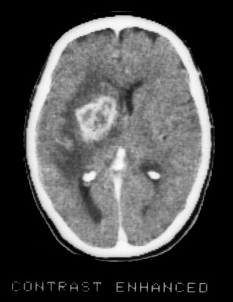

Slide 32
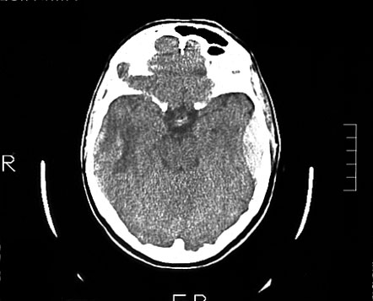

Slide 33
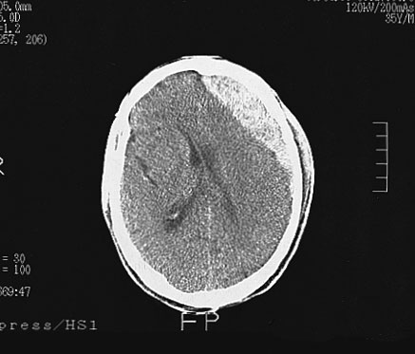

Slide 34
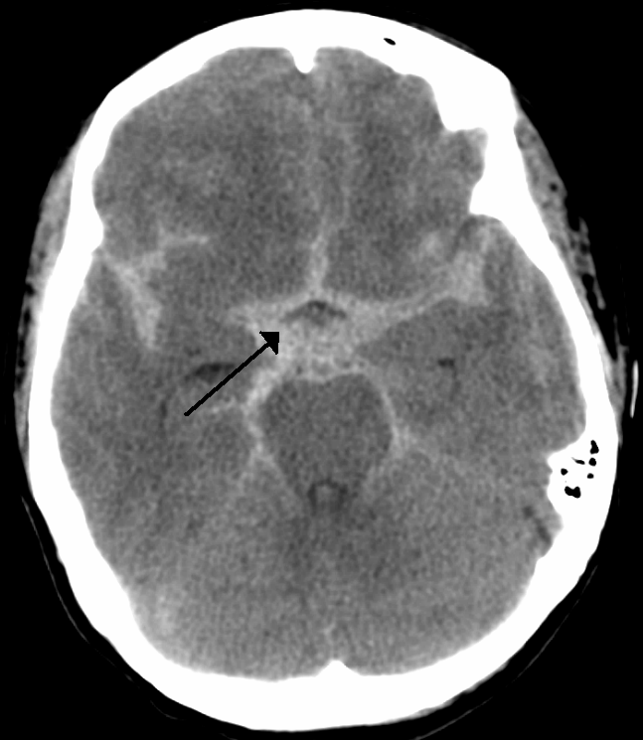

Slide 35
THANK YOU

