Slide 1
BRAIN STEM
Lecture - 7
Dr Zahoor

Slide 2
Objectives
Describe the components of Brain stem.
Enumerate different functions of brainstem.
Know the reticular formation and its activating & inhibiting system
Role of brainstem in brain death.

Slide 3
BRAIN STEM
Brain Stem consists of
1. Mid brain
2. Pons
3. Medulla

Slide 4
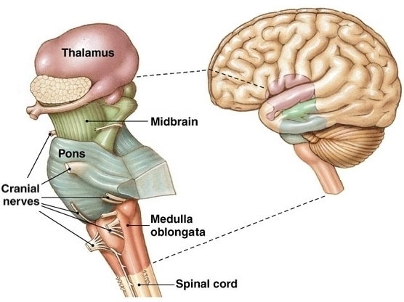

Slide 5
FUNCTIONS OF BRAIN STEM
Origin of majority of peripheral cranial nerves
Cardiovascular, respiratory, and digestive control centers
Regulation of muscle reflexes involved with equilibrium and posture

Slide 6
FUNCTIONS OF BRAIN STEM (cont)
Reception and integration of all synaptic input from spinal cord
arousal and activation of cerebral cortex
Role in sleep wake cycle

Slide 7
BRAIN STEM
Brain stem is important link between spinal cord and the higher brain regions
All incoming fibers from periphery to brain and out coming fiber from brain to periphery must pass through brain stem
Most of these fibers synapse within brain stem for important processing

Slide 8
FUNCTIONS OF BRAIN STEM
We will look at the functions of Brain Stem
1. Cranial nerves – most of the 12 pairs of cranial nerves arise from brain stem (except first and second cranial nerve that is olfactory and optic cranial nerve)
Cranial nerves arising from brain stem
Mid-brain – III, IV
Pons – V, VI, VII, VIII
Medulla – IX, X, XI, XII

Slide 9
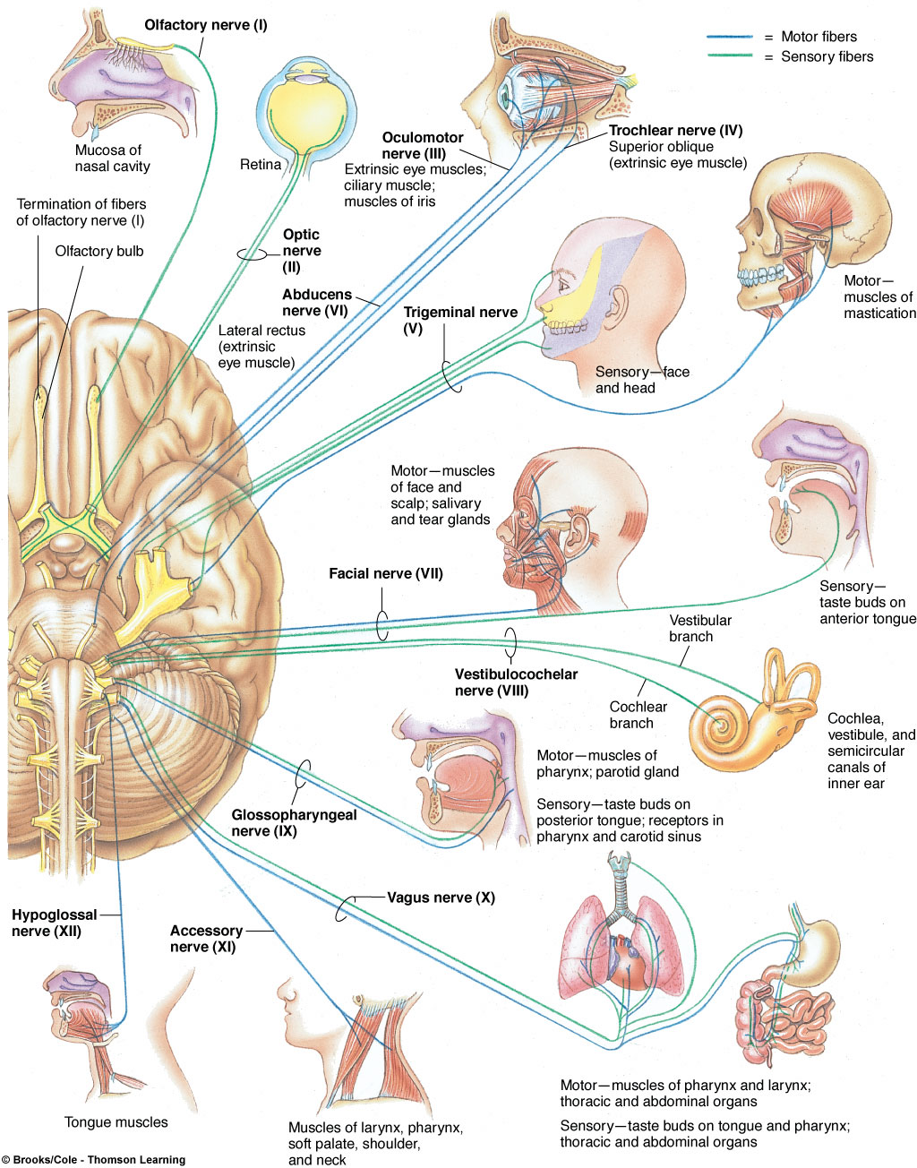
Cranial Nerves

Slide 10
Cranial Nerves
No. | Cranial Nerve | Major Functions
I | Olfactory | smell
II | Optic | vision
III | Oculomotor | eyelid and eyeball movement
IV | Trochlear | innervates superior oblique turns eye downward and laterally
V | Trigeminal | chewing face & mouth touch & pain
VI | Abducens | turns eye laterally
VII | Facial | controls most facial expressions secretion of tears & saliva taste

Slide 11
Cranial Nerves
No. | Cranial Nerve | Major Functions
VIII | Vestibulocochlear (auditory) | hearing equilibrium sensation
IX | Glossopharyngeal | taste senses carotid blood pressure
X | Vagus | senses aortic blood pressure slows heart rate stimulates digestive organs taste
XI | Spinal Accessory | controls trapezius & sternocleidomastoid controls swallowing movements
XII | Hypoglossal | controls tongue movements

Slide 12
APPLIED
We will see some slides of cranial nerve palsy

Slide 13
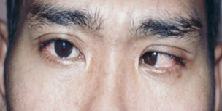
6th Cranial Nerve Palsy Left Eye

Slide 14
7th Cranial Nerve Palsy Right side

Slide 15
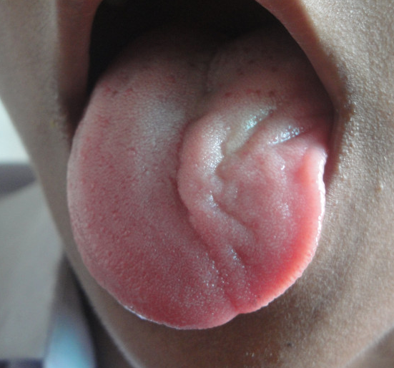
Left 12th Cranial Nerve Palsy
Wasting of tongue muscle on left side

Slide 16
FUNCTIONS OF BRAIN STEM (cont)
2. In Brain stem, there are centers (collection of neuronal cell bodies)
- Control of heart and blood vessels (cardiovascular center)
- Respiratory control center
- Sneezing , Coughing center
- Digestive activities (swallowing, vomiting center)
- Posture control
- Control of eye movements

Slide 17
Functions of Brain stem (cont)
_ Cardiovascular center ( Sympathetic output)
It controls Myocardial contractility
Controls Blood Pressure
Controls diameter of blood vessels ( small arteries and arterioles )

Slide 18
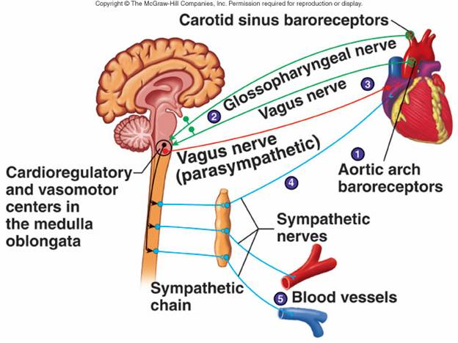
VASOMOTOR CENTER

Slide 19
FUNCTIONS OF BRAIN STEM (cont)
Respiratory centers
i) Medulla – Inspiratory and expiratory center
ii) Pons – Apneustic center (lower pons)
– Pneumotaxic center (upper pons)

Slide 20
Respiratory Centers
Dorsal respiratory group (DRG)
Contains inspiratory center
Functions in every respiratory cycle
Ventral respiratory group (VRG)
Contains expiratory center
Used only during forced breathing
Pneumotaxic center in pons, play a role in switching between inspiration and expiration
Apneustic center in pons, promotes inspiration by stimulating the inspiratory neurons in the medulla.

Slide 21
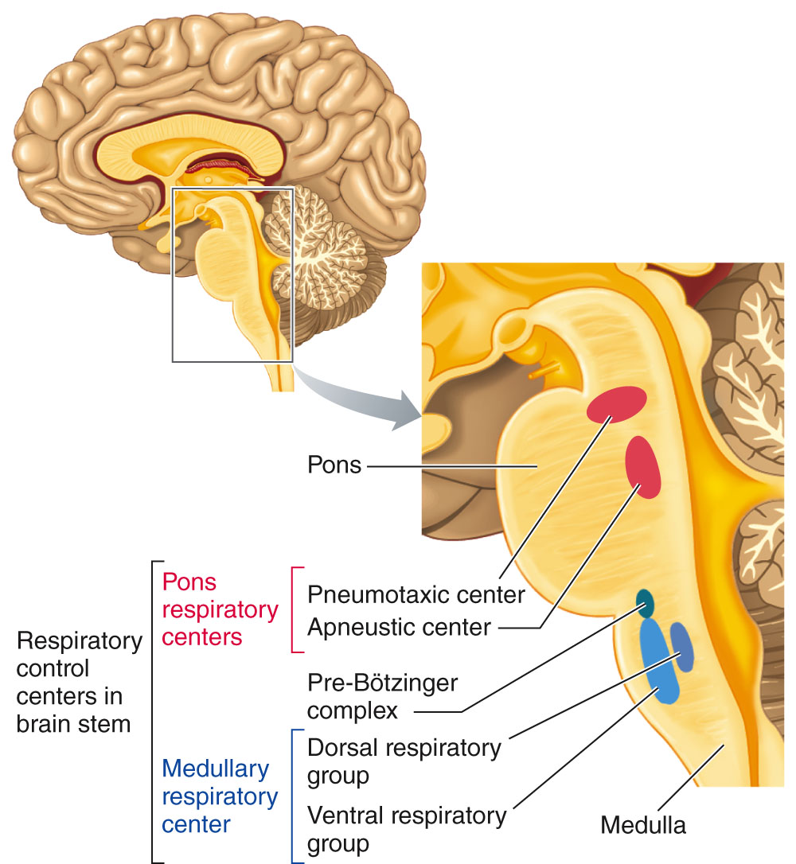
Respiratory control centers in brain stem

Slide 22
FUNCTIONS OF BRAIN STEM (cont)
3. Brain stem helps to regulate muscle reflexes involved in equilibrium and posture
Why?
Because of extra pyramidal tracts arising from brain stem.
Extra pyramidal tracts- Pontine and Medullary
( Reticulospinal, Vestibulospinal, Tectospinal )

Slide 23
Brain stem
Extra pyramidal tracts
They descend ipsilateral and terminate on the interneurons in ventral horn cells of spinal cord to control axial and proximal muscles.
Extra pyramidal tracts are involved
- in maintenance of posture
- Modulating muscle tone via input to gamma efferent neuron.

Slide 24
FUNCTIONS OF BRAIN STEM (cont)
4. Reticular formation
- It runs through brain stem into thalamus to cerebral cortex
- Ascending fibers going from reticular formation to cerebral cortex cause activation of cerebral cortex and arousal
- Reticular activating system (RAS) controls cortical alertness

Slide 25
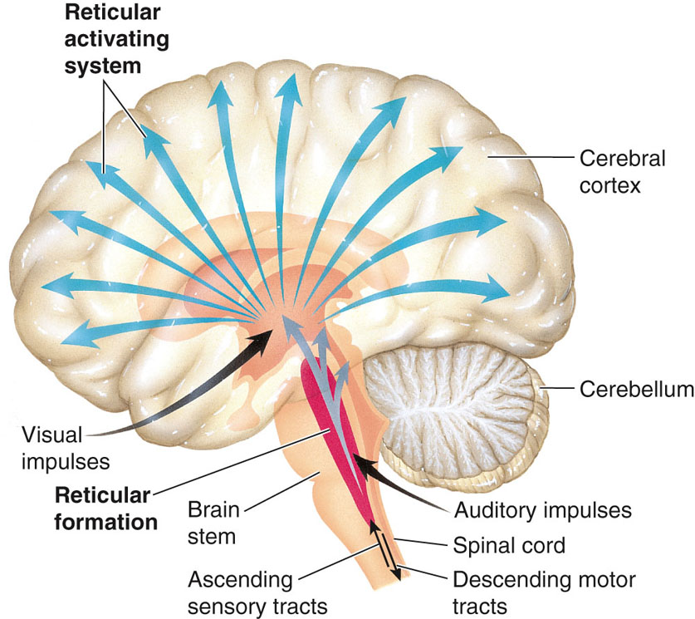
The Reticular activating system

Slide 26
FUNCTIONS OF BRAIN STEM (cont)
5. Brain stem has centers that govern sleep
6. Brain stem has Satiety center, known as Nucleus Tractors Solitarius (NTS)
It gives the feeling of being full after taking the meals, as it receives afferent input from digestive tract

Slide 27
The brainstem controls several important functions of the body Summary
Alertness
Arousal
Breathing
Blood Pressure
Digestion
Heart Rate
Other Autonomic Functions
Relays Information Between the Peripheral Nerves and Spinal Cord to the Upper Parts of the Brain

Slide 28
BRAIN STEM FUNCTIONS (cont)
Visual reflex center
Auditory reflex center
eye movement, and
body movement.

Slide 29
FUNCTIONS OF BRAIN STEM (cont)
Important
Brain stem controls many life sustaining processes such as respiration, circulation, and digestion
They are referred as vegetative functions – meaning involuntary functions performed unconsciously

Slide 30
BRAIN STEM
What is Vegetative Life?
With loss of higher brain functions, lower brain levels, inconjunction with supportive therapy that is providing adequate nourishment can sustain life but person has no awareness or control of life.
This condition is described as Vegetative Life.

Slide 31
BRAIN DEATH
What is Brain death?
- Brain death is irreversible cessation of all cerebral functions, including those of both cerebral hemispheres and brain stem.
- Brain is not functioning with no possibility of recovery.

Slide 32
BRAIN DEATH (cont)
- EEG shows electrocerebral silence that is flat EEG ,showing no recording of electrical activity of brain

Slide 33
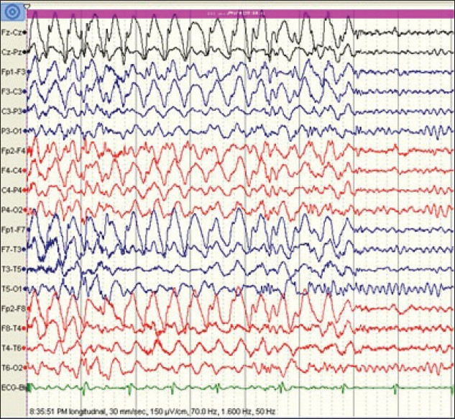
EEG RECORDING SHOWING WAVES

Slide 34
EEG SHOWING RECORDING OF NO WAVES INDICATIVE OF BRAIN DEATH

Slide 35
BRAIN DEATH (cont)
In Brain death, person has stopped breathing and heart may have stopped pumping blood
It is often possible to restore and maintain respiratory and circulatory activity if resuscitative measures are started soon

Slide 36
BRAIN DEATH (cont)
The determination that comatose patient maintained by artificial respiration and other supportive measure is alive or dead has important medical, legal, and social implications
The need for organ transplant has made the timeline for such life or death determination very important

Slide 37
BRAIN DEATH (cont)
Preconditions
Patient must be unresponsive and on ventilator with no spontaneous respiratory effort
Irremediable structural brain damage (that can cause brain stem death) must have been diagnosed as head injury, intracranial hemorrhage

Slide 38
BRAIN DEATH (cont)
Exclude Reversible causes
Poisoning, sedative drugs
Hypothermia
Endocrine cause (hypothyroidism)
Plasma electrolyte, acid base balance disorder
Blood glucose level abnormalities

Slide 39
Brain Death (cont)
Diagnostic Test
Pupils are fixed and unresponsive to light
Corneal reflexes are absent
No motor response to painful stimuli within cranial nerve territory
Spontaneous Respiration is absent.
SPINAL REFLEXES ARE PRESENT

Slide 40
Brain Death (cont)
Examination is performed by TWO SENIOR DOCTORS . The tests are usually repeated after 6- 24 hours.
Confirmation Test – EEG is flat ( No electrical activity of brain is present ).
Note – EEG is no longer necessary to confirm the diagnosis.

Slide 41
Brain stem death
Brain death occurs when a person no longer has any activity in their brain stem and no potential for consciousness
Brain death can occur when the blood and oxygen supply to the brain is stopped for example due to cardiac arrest, cerebrovascular accident etc
When brain stem function is permanently and irreversibly lost, the person will be confirmed dead

Slide 42
Brain stem death (cont)
A ventilator machine may maintain ventilation and oxygenation and keep the heart beating and oxygen circulating through the blood
But once the brain stem has permanently irreversibly stopped functioning the heart will eventually stop beating even if a ventilator has been used
Brain death is considered as a clinical syndrome charcterized by the absence of reflexes that have pathways through the brain stem in a deeply comatose, ventilator-dependent, patient.

Slide 43
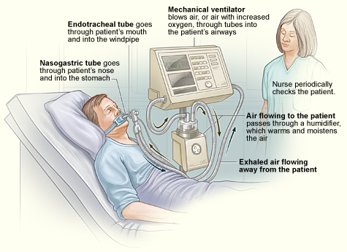

Slide 44
THANK YOU

