Slide 1
Elasticity of Lungs, Compliance, Alveolar Surface Tension, Pulmonary Surfactant
Lecture – 4
Dr.Zahoor Ali Shaikh

Slide 2
Elastic Behavior Of The Lungs
Elastic Behavior of the lungs is due to elastic connective tissue and alveolar surface tension.
During Inspiration – lungs expand.
During Expiration – lungs recoil [come back to same position].

Slide 3
Elastic Behavior Of The Lungs
What makes the lungs to behave like balloon?
Due to two things:
1. Compliance
2. Elastic recoil
What is Compliance?
It is a change in lung volume per unit change in airway pressure.
It is the stretchability of the lungs.

Slide 4
Compliance
It measures how much change in lung volume will take place for a given change in Transmural pressure gradient, the force that stretches the lungs.
If compliance is decreased [decreased expansion of the lungs] large transmural pressure will be required to produce normal lung expansion.

Slide 5
Compliance
If lung is less compliant, it is called ‘Stiff Lung’ [as it lacks normal stretchability].
Clinical Application
Lung compliance is decreased in pulmonary fibrosis, when normal lung tissue is replaced by fibrous connective tissue due to breathing of dust e.g. Asbestos Fiber.

Slide 6
Elastic Recoil
Elastic Recoil refers, how quickly the lungs rebound [come back to normal] after they have been stretched.
Pulmonary Elastic behavior depends on two factors:
1. Connective Tissue in Lungs
2. Alveolar Surface Tension

Slide 7
Pulmonary Elastic Connective Tissue
Connective tissue in lungs contains lot of elastin fiber surrounding the alveolus , which is responsible for expansion and elastic recoil of lung.

Slide 8
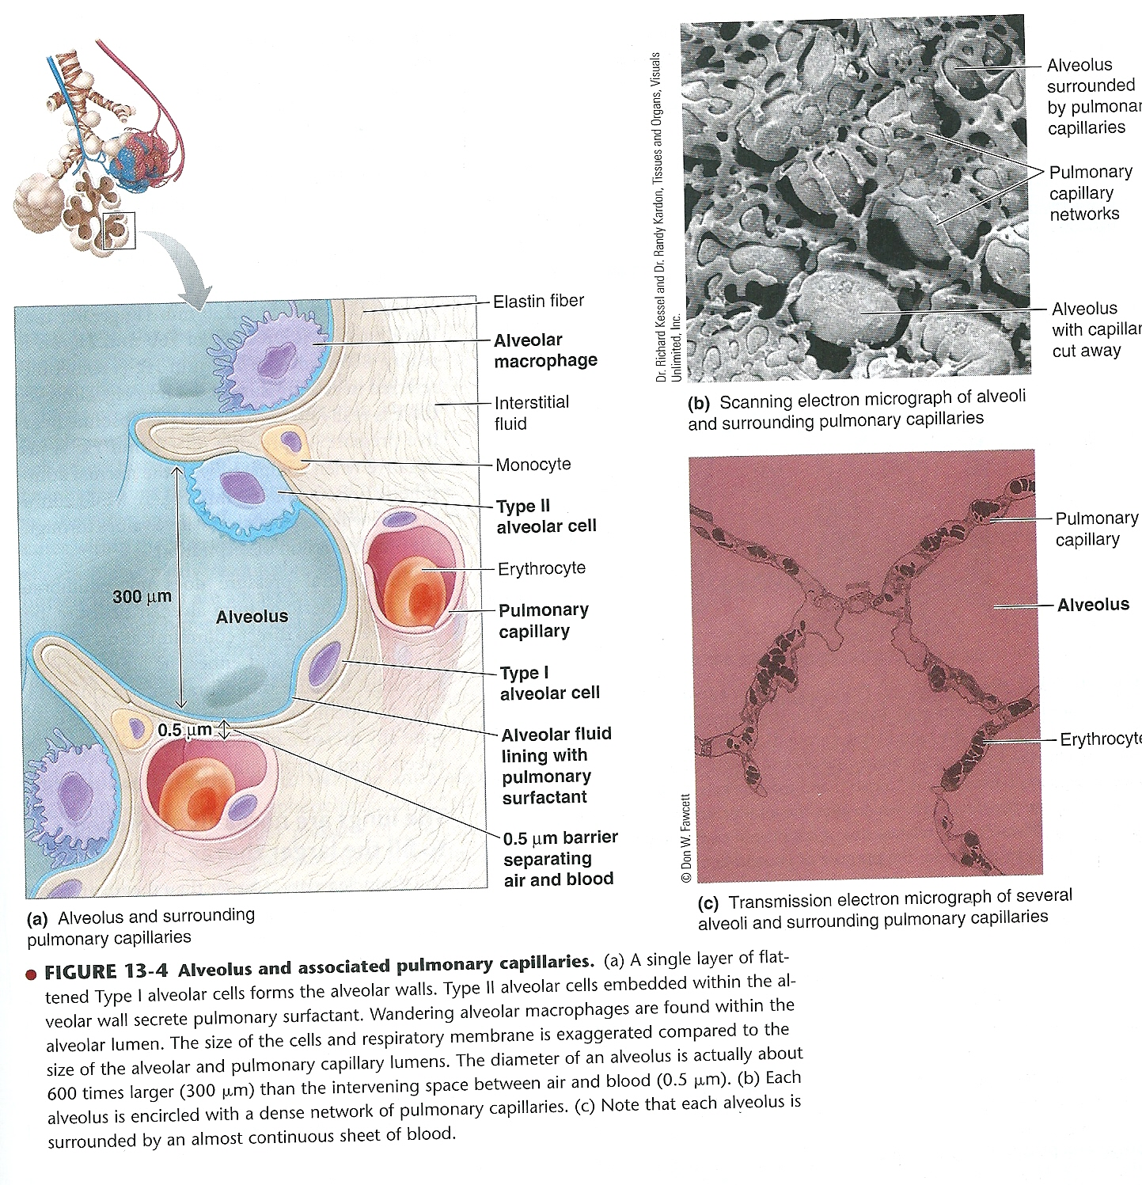

Slide 9
Alveolar Surface Tension
Most important factor affecting the elastic behavior of the lungs is the alveolar surface tension.
What is Alveolar Surface Tension?
As a thin liquid film lines each alveolus, there is air – water interface.
Water molecules are strongly attracted to other water molecules by hydrogen bonds.

Slide 10
Alveolar Surface Tension
This unequal attraction of Hydrogen bonds produces a force called ‘Surface Tension’.
Surface tension has two effects:
1. It opposes expansion of alveoli [therefore causes collapse of the alveoli].
Increased surface tension – decreased compliance [stretchability].
2. It reduces the size of alveolus.

Slide 11
Important
Compliance – it is the expansion of the lung.
Elastic recoil means lungs come back to normal size [during expiration].

Slide 12
Pulmonary Surfactant
It is a complex mixture of lipids and proteins secreted by Type II alveolar cell.
It intersperses between the water molecules in the fluid lining the alveoli, therefore, lowers the surface tension.
By lowering the alveolar surface tension, pulmonary surfactant provides 2 important benefits.

Slide 13
Pulmonary Surfactant
Benefits of Surfactant:
1. It increases pulmonary compliance [stretchability].
2. It prevents the collapse of alveoli.

Slide 14
Why Alveoli Do Not Collapse?
Surface tension present in the alveoli tends to cause collapse of alveoli but because of pulmonary surfactant which decreases the surface tension in alveoli and stabilizes the size of alveoli and keeps them open.

Slide 15
Alveolar Interdependence
Alveoli are surrounded by other alveoli and interconnected by connective tissue.
If alveolus starts to collapse, surrounding alveoli are stretched and they apply expanding forces on the collapsing alveolus, thereby help to keep it open, this is called Alveolar Interdependence.

Slide 16
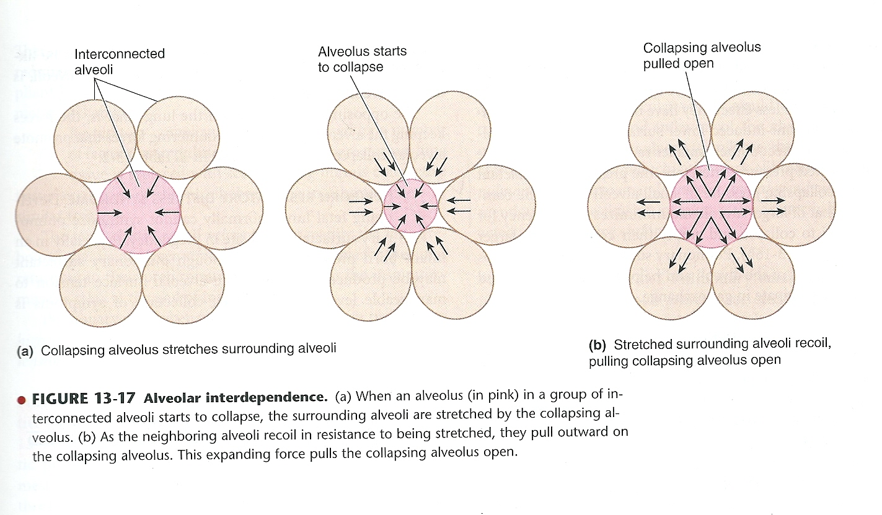

Slide 17
Respiratory Distress Syndrome Of New Born
Lungs normally synthesize pulmonary surfactant by 35th week of pregnancy [normal pregnancy is 40 week].
If infant is born prematurely,(30th week 0f pregnancy) not enough pulmonary surfactant may be produced to reduce the alveolar surface tension.
Therefore symptoms of respiratory distress occur in new born.

Slide 18
Respiratory Distress Syndrome Of New Born
The symptoms are:
1. Inspiratory difficulty [infant makes very strong inspiratory effort to overcome the high surface tension to inflate the poorly compliant lungs].
2. Work of breathing is further increased because absence of surfactant tends to collapse the alveoli during expiration.
3. It requires greater transmural pressure to expand a collapsed alveolus.

Slide 19
Respiratory Distress Syndrome Of New Born
New born respiratory muscles are weak, therefore, new born respiratory distress syndrome may lead to death if breathing becomes so difficult to support gas exchange in alveoli.
Treatment
- Condition is treated by surfactant replacement until surfactant – secreting cells mature.
- Drugs can hasten the maturing process of Type II alveolar cells, which secrete surfactant.

Slide 20
Summary of forces acting on the lung to keep the alveoli open and forces promoting alveolar collapse

Slide 21
Work of Breathing during Normal Respiration
During normal quite breathing, respiratory muscles work during inspiration to expand the lungs, whereas expiration is a passive process.
Normally lungs are highly compliant and airway resistance is low, so only 3% of total energy is used by the body during quite breathing.

Slide 22
Clinical Application
Work of breathing may be increased:
1. Pulmonary Fibrosis – more work is required to expand the lung as pulmonary compliance is decreased.
2. COPD [Chronic Obstructive Pulmonary Disease] – when airway resistance is increased, more work is required to overcome the resistance.

Slide 23
What You Should Know From This Lecture
Factors causing alveoli to collapse
Factors causing alveoli to expand
Elastic recoil of lungs
Alveolar Surface Tension
Compliance
Pulmonary Surfactant
Alveolar Interdependence
Respiratory Distress Syndrome
Effect of Restrictive and Obstructive Lung Conditions on work of breathing

Slide 24
Thank you

